Slide 1


Noida Institute of Engineering and Technology, Greater Noida
Aptitude IV
Unit: V
Subject Name:Optimization And Numerical Techniques
Subject code:(AAS0404)
Mr. Raman Chauhan
Department of
Mathematics
B Tech 4th Sem DS/AI/AIML

Slide 2


Brief Introduction of Faculty
Faculty Name: Mr. Raman Chauhan
Education Qualification: M.Sc Mathematics (IIT Roorkee)
Exam Qualified: IIT-JAM, GATE Exam

Slide 3
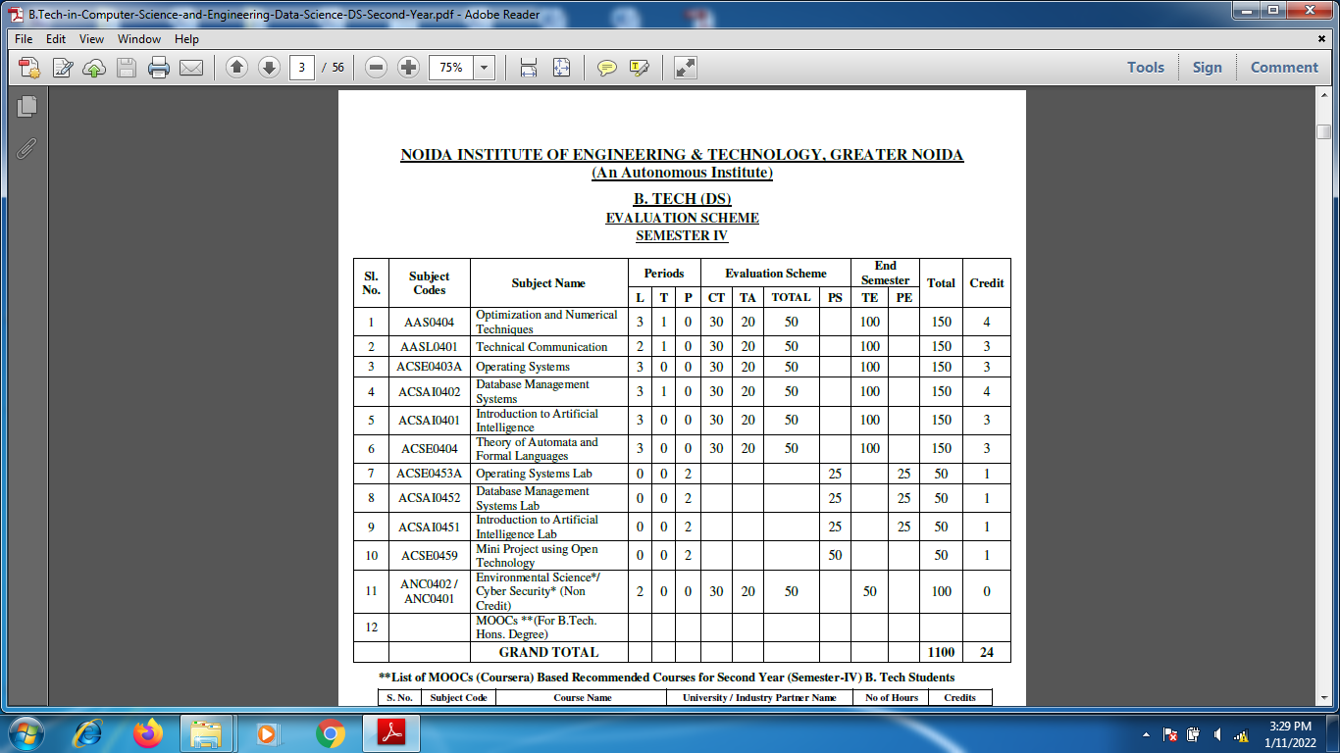
Evaluation Scheme

Slide 4
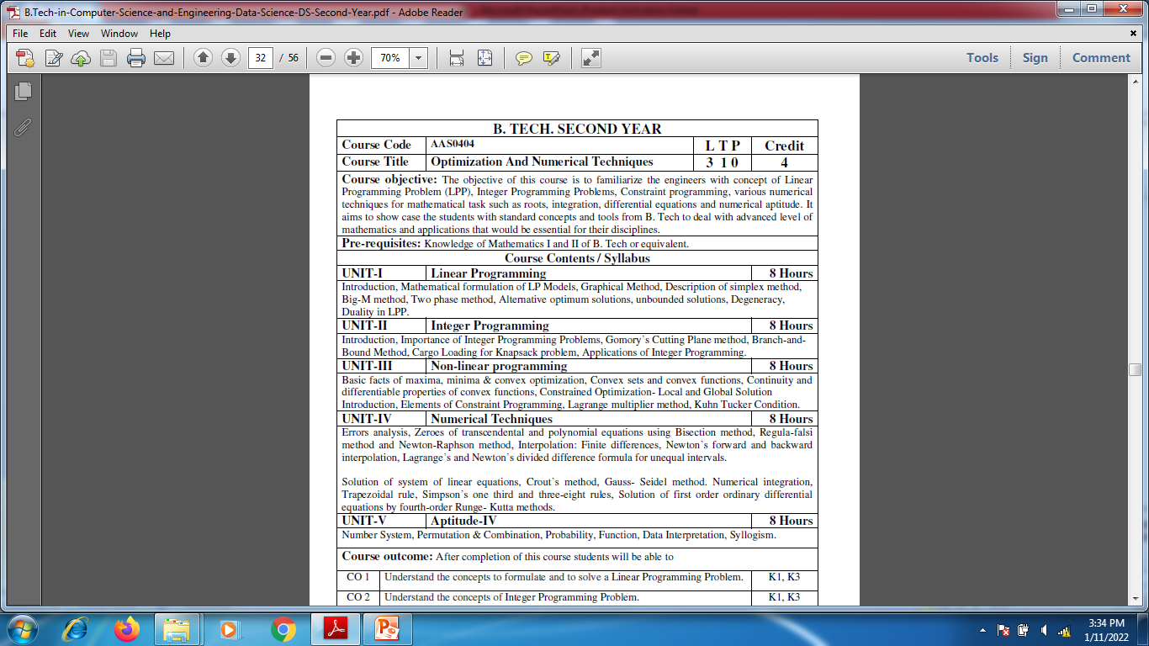
Syllabus

Slide 5
Course Objective
Course objective: The objective of this course is to familiarize the engineers with concept of Linear Programming Problem (LPP), Integer Programming Problems, Constraint programming, various numerical techniques for mathematical task such as roots, integration, differential equations and numerical aptitude. It aims to show case the students with standard concepts and tools from B. Tech to deal with advanced level of mathematics and applications that would be essential for their disciplines. The student will be able to understand:
The concept of Linear Programming Problem .
The concept of Integer Programming Problems.
The concept of Non-Linear Programming Problem .
The concept of Numerical Techniques.
The concept of Numerical aptitude.

Slide 6
Course Outcome
CO1: Understand the concepts to formulate and to solve a Linear Programming Problem .
CO2: Understand the concepts of Integer Programming Problem.
CO3: Understand the concepts of Non- Linear Programming Problem .
CO4: Apply the concept of numerical techniques to evaluate the zeroes of the equation, concept of interpolation and numerical methods for various mathematical operations and tasks, such as integration, the solution of linear system of equations and the solution of differential equation.
CO5: Solve the problems of Number System, Permutation & Combination, Probability, Function, Data Interpretation, Syllogism.

Slide 7
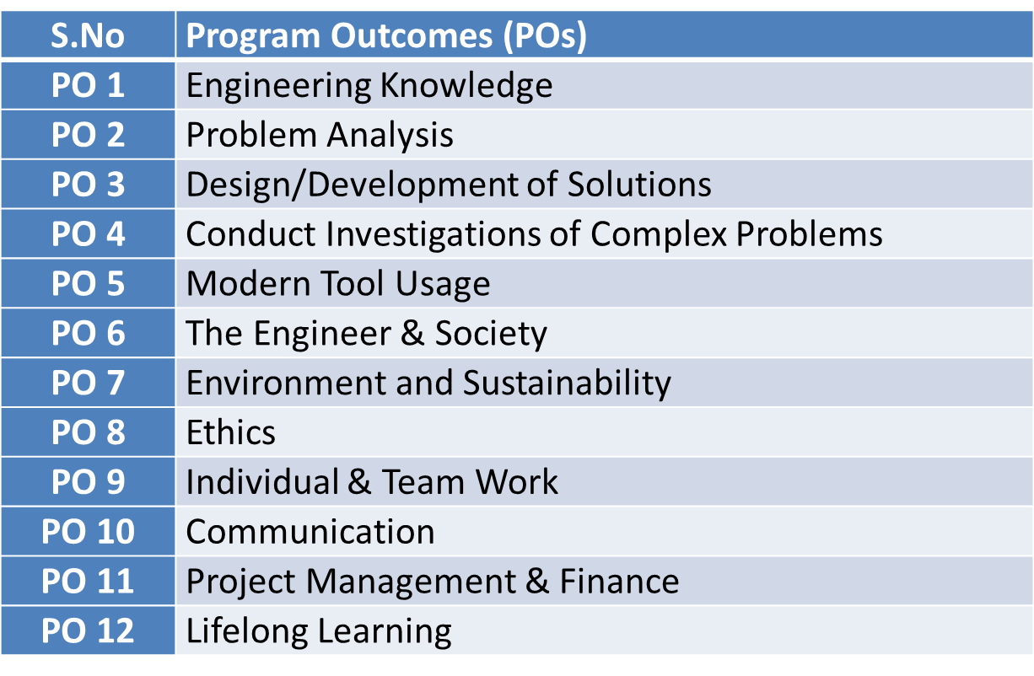
Program Outcomes

Slide 8
CO-PO Mapping(CO5)
Sr. No | Course Outcome | PO1 | PO2 | PO3 | PO4 | PO5 | PO6 | PO7 | PO8 | PO9 | PO10 | PO11 | PO12
1 | CO1 | H | H | H | H | L | L | L | L | L | L | L | M
2 | CO2 | H | H | H | H | L | L | L | L | L | L | M | M
3 | CO3 | H | H | H | H | L | L | L | L | L | L | M | M
4 | CO4 | H | H | H | H | L | L | L | L | L | L | L | M
5 | CO5 | H | H | H | H | L | L | L | L | L | L | M | M
*L= Low *M= Medium *H= High

Slide 9
PSO
PSO | Program Specific Outcomes(PSOs)
PSO1 | The ability to identify, analyze real world problems and design their ethical solutions using artificial intelligence, robotics, virtual/augmented reality, data analytics, block chain technology, and cloud computing
PSO2 | The ability to design and develop the hardware sensor devices and related interfacing software systems for solving complex engineering problems.
PSO3 | The ability to understand inter disciplinary computing techniques and to apply them in the design of advanced computing.
PSO4 | The ability to conduct investigation of complex problem with the help of technical, managerial, leadership qualities, and modern engineering tools provided by industry sponsored laboratories.

Slide 10
CO-PSO Mapping(CO5)
CO | PSO1 | PSO2 | PSO3 | PSO4
CO.1 | H | L | M | L
CO.2 | L | M | L | M
CO.3 | M | M | M | M
CO.4 | H | M | M | M
CO.5 | H | M | M | M
*L= Low *M= Medium *H= High

Slide 11
Program Educational Objectives(PEOs)
PEO-1: To have an excellent scientific and engineering breadth so as to comprehend, analyze, design and provide sustainable solutions for real-life problems using state-of-the-art technologies.
PEO-2: To have a successful career in industries, to pursue higher studies or to support entrepreneurial endeavors and to face the global challenges.
PEO-3: To have an effective communication skills, professional attitude, ethical values and a desire to learn specific knowledge in emerging trends, technologies for research, innovation and product development and contribution to society.
PEO-4: To have life-long learning for up-skilling and re-skilling for successful professional career as engineer, scientist, entrepreneur and bureaucrat for betterment of society.

Slide 12
Result Analysis

Slide 13
End Semester Question Paper

Slide 14
Prerequisite and Recap(CO5)
Knowledge of Mathematics I ,II and III of B. Tech or equivalent.

Slide 15
Brief Introduction about the subject with videos
In first three modules, we will discuss Optimization Techniques.
In 4th & 5th module we will discuss Numerical Techniques & aptitude part.

Slide 16
Branch wise Application
To improve skills
Useful in various Competition Exams

Slide 17
Unit Content(CO5)
Number System
Permutation & Combination
Probability
Function
Data Interpretation
Syllogism

Slide 18
Unit Objective(CO5)
The objective of this unit is to familiarize the engineers with Aptitude.

Slide 19
Topic objective (CO5)
Number System
Understand the concept of various type of numbers & Its divisibility.

Slide 20
Number System (CO5)
Number System is divided into 4 parts:
Classification
Divisibility Test
Division and Remainder Rules
Sum Rules

Slide 21
Number System (CO5)
TRICKS TO REMEMBER FOR NUMBER SYSTEM:
1. Classification:
Types | Description
Natural Numbers | all counting numbers ( 1,2,3,4,5….∞)
Whole Numbers | natural number + zero( 0,1,2,3,4,5…∞)
Integers | All whole numbers including Negative number + Positive number (∞……-4,-3,-2,-1,0,1,2,3,4,5….∞)
Even & Odd Numbers | All whole number divisible by 2 is Even (0,2,4,6,8,10,12…..∞) and which does not divide by 2 are Odd (1,3,5,7,9,11,13,15,17,19….∞)
Prime Numbers | it can be positive or negative except 1, if the number is not divisible by any number except the number itself.(2,3,5,7,11,13,17,19,23,29,31,37,41,43,47,53,59,61….∞)
Composite Numbers | Natural numbers which are not prime.
Co-Prime | Two natural number a and b are said to be co-prime if their HCF is 1.

Slide 22
Number System (CO5)
2. Divisibility:
Numbers | if a Number
Divisible by 2 | End with 0,2,4,6,8 are divisible by 2
Divisible by 3 | Sum of its digits is divisible by 3
Divisible by 4 | Last two digit divisible by 4
Divisible by 5 | Ends with 0 or 5
Divisible by 6 | Divides by Both 2 & 3
Divisible by 8 | Last 3 digit divide by 8
Divisible by 10 | End with 0
Divisible by 11 | [Sum of its digit in odd places-Sum of its digits in even places]= 0 or multiple of 11
Divisible by 12 | [The number must be divisible by 3 and 4]

Slide 23
Number System (CO5)
Divisible by 13 | [Multiply last digit with 4 and add it to remaining number in given number, result must be divisible by 13]
Divisible by 14 | [The number must be divisible by 2 and 7. Because 2 and 7 are prime factors of14.]
Divisible by 15 | [The number should be divisible by 3 and 5. Because 3 and 5 are prime factors of15.]
Divisible by 16 | [The number formed by last four digits in given number must be divisible by 16.]
Divisible by 17 | [Multiply last digit with 5 and subtract it from remaining number in given number, result must be divisible by 17]
Divisible by 18 | [The number should be divisible by 2 and 9]
Divisible by 19 | [Multiply last digit with 2 and add it to remaining number in given number, result must be divisible by 19]
Divisible by 20 | [The number formed by last two digits in given number must be divisible by 20.]

Slide 24
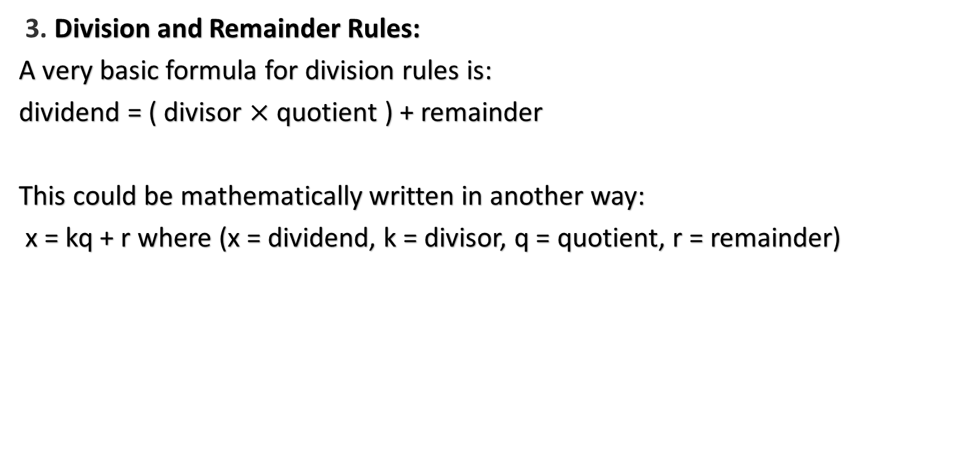
Number System (CO5)
3. Division and Remainder Rules:
A very basic formula for division rules is:
dividend = ( divisor $×$quotient ) + remainder
This could be mathematically written in another way:
x = kq + r where (x = dividend, k = divisor, q = quotient, r = remainder)

Slide 25

Number System (CO5)
Method to find the number of different divisors of any composite number $N$:
STEP I: Express $N$ as a product of prime numbers as.
$$N=x^{a}×y^{b}×z^{c}$$
STEP II: Number of different divisors $=(a+1)(b+1)(c+1)$

Slide 26
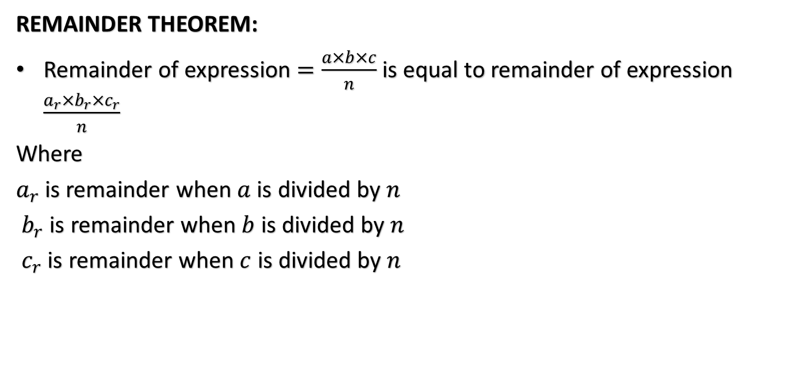
Number System (CO5)
REMAINDER THEOREM:
Remainder of expression $=\frac{a×b×c}{n}$ is equal to remainder of expression $\frac{a_{r}×b_{r}×c_{r}}{n}$
Where
$a_{r}$ is remainder when $a$ is divided by $n$
$b_{r}$ is remainder when $b$ is divided by $n$
$c_{r}$ is remainder when $c$ is divided by $n$

Slide 27
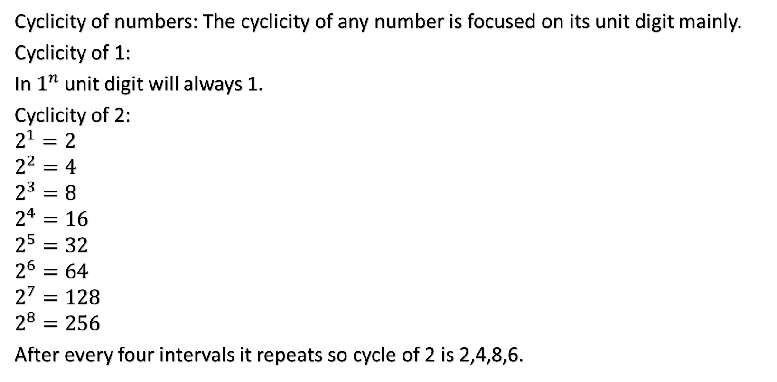
Number System (CO5)
Cyclicity of numbers: The cyclicity of any number is focused on its unit digit mainly.
Cyclicity of 1:
In $1^{n}$ unit digit will always 1.
Cyclicity of 2:
$$2^{1}=2$$
$$2^{2}=4$$
$$2^{3}=8$$
$$2^{4}=16$$
$$2^{5}=32$$
$$2^{6}=64$$
$$2^{7}=128$$
$$2^{8}=256$$
After every four intervals it repeats so cycle of 2 is 2,4,8,6.

Slide 28
Number System (CO5)
Cyclicity Table:
Number | Cyclicity
1 | 1
2 | 2,4,6,8
3 | 3,9,7,1
4 | 4,6
5 | 5
6 | 6
7 | 7,9,3,1
8 | 8,4,2,6
9 | 9,1
0 | 0

Slide 29
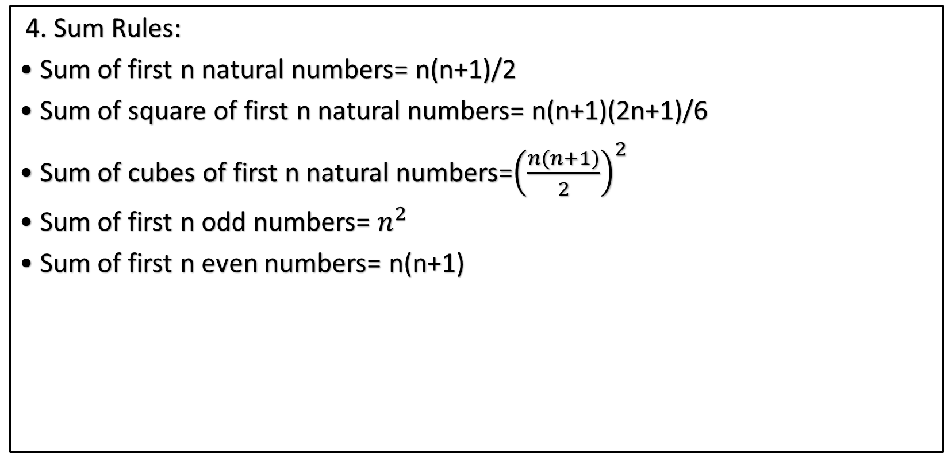
Number System (CO5)
4. Sum Rules:
• Sum of first n natural numbers= n(n+1)/2
• Sum of square of first n natural numbers= n(n+1)(2n+1)/6
• Sum of cubes of first n natural numbers=${\left(\frac{n(n+1)}{2}\right)}^{2}$
• Sum of first n odd numbers= $n^{2}$
• Sum of first n even numbers= n(n+1)

Slide 30
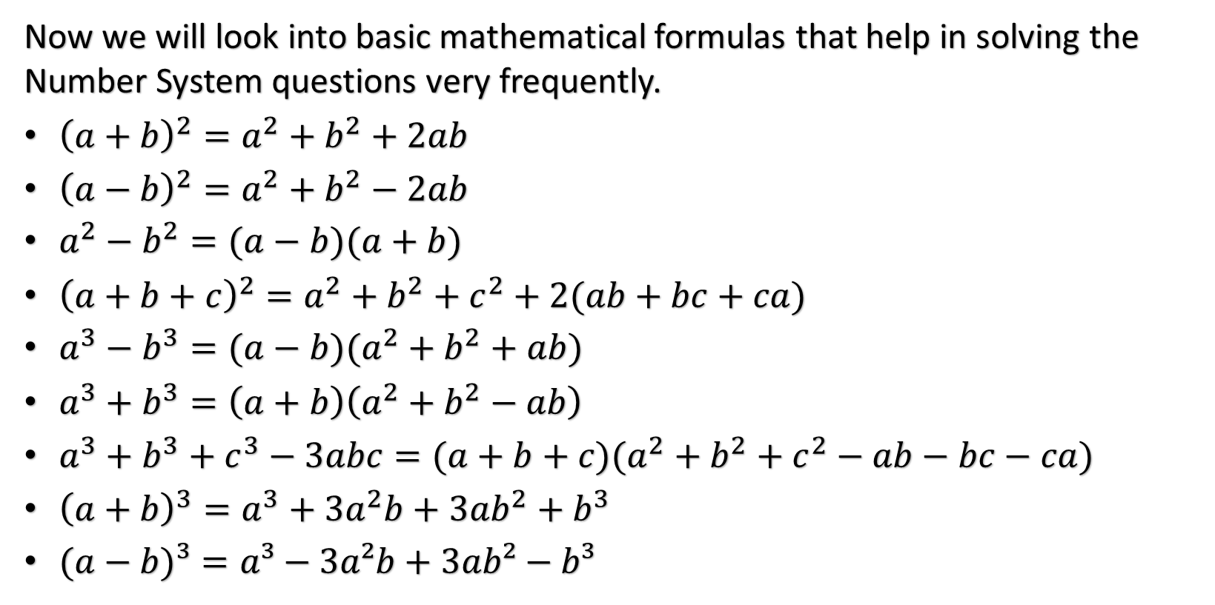
Number System (CO5)
Now we will look into basic mathematical formulas that help in solving the Number System questions very frequently.
${\left(a+b\right)}^{2}=a^{2}+b^{2}+2ab$
${\left(a−b\right)}^{2}=a^{2}+b^{2}−2ab$
$a^{2}−b^{2}=(a−b)(a+b)$
${\left(a+b+c\right)}^{2}=a^{2}+b^{2}+c^{2}+2(ab+bc+ca)$
$a^{3}−b^{3}=(a−b)(a^{2}+b^{2}+ab)$
$a^{3}+b^{3}=\left(a+b\right)\left(a^{2}+b^{2}−ab\right)$
$a^{3}+b^{3}+c^{3}−3abc=(a+b+c)(a^{2}+b^{2}+c^{2}−ab−bc−ca)$
${\left(a+b\right)}^{3}=a^{3}+3a^{2}b+3ab^{2}+b^{3}$
$(a−b)³=a³−3a²b+3ab²−b³$

Slide 31
Number System (CO5)
Q1. Is 2331024 divisible by 12
Solution:
12 = 4 × 3
2331024 is divisible by 3 as (2+3+3+1+2+4)=15 is divisible by 3
2331024 is also divisible by 4 because last two digits (24) is divisible by
4
Therefore 2331024 is divisible by 12

Slide 32
Number System (CO5)
Q2. What is the value of M and N respectively if M39048458N is divisible by 8 and 11, where M and N are single digit integers?
Solution:
A number is divisible by 8 if the number formed by the last three digits is divisible by 8. i.e., 58N is divisible by 8.
Clearly, N = 4
Again, a number is divisible by 11 if the difference between the sum of digits at even places and sum of digits at the odd places is either 0 or is divisible by 11.
i.e. (M+9+4+4+8) – (3+0+8+5+N) = M + 25 – (16 + N)
= M – N + 9 must be zero or it must be divisible by 11
i.e. M – N = 2 ⇒ M = 2 + 4 = 6
Hence, M = 6; N = 4

Slide 33
Number System (CO5)
Q3. A certain number when divided by 899 leaves the remainder 63. Find the remainder when the same number is divided by 29.
Sol:
Number = 899Q+63, where Q is quotient
= 31 × 29Q+ (58 + 5) =29[31Q+2] + 5
∴Remainder = 5

Slide 34
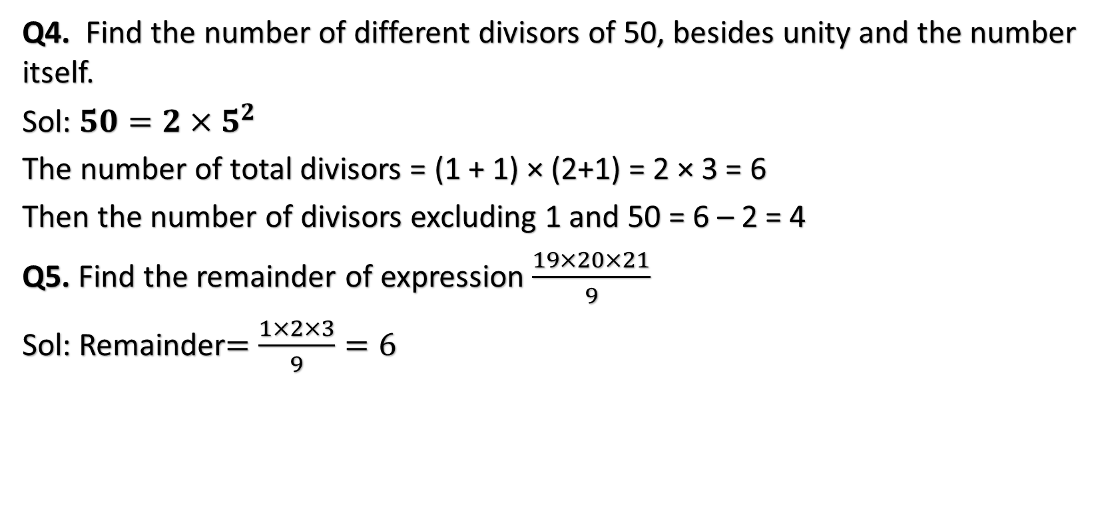
Number System (CO5)
Q4. Find the number of different divisors of 50, besides unity and the number itself.
Sol: $50=2×5^{2}$
The number of total divisors = (1 + 1) × (2+1) = 2 × 3 = 6
Then the number of divisors excluding 1 and 50 = 6 – 2 = 4
Q5. Find the remainder of expression $\frac{19×20×21}{9}$
Sol: Remainder$=$$\frac{1×2×3}{9}=6$

Slide 35
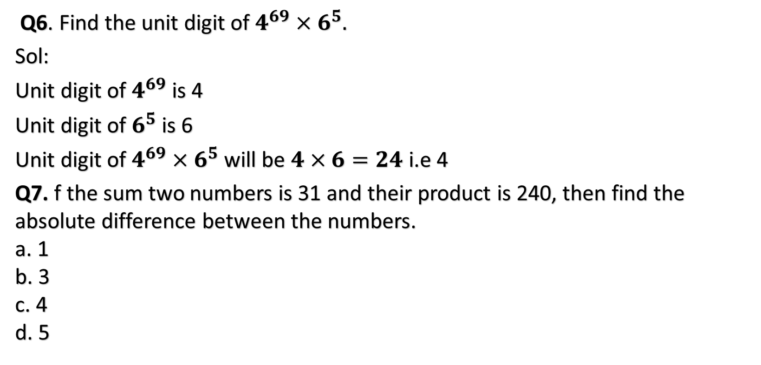
Number System (CO5)
Q6. Find the unit digit of $4^{69}×6^{5}.$
Sol:
Unit digit of $4^{69}$ is 4
Unit digit of $6^{5}$ is 6
Unit digit of $4^{69}×6^{5}$ will be $4×6=24$i.e 4
Q7. f the sum two numbers is 31 and their product is 240, then find the absolute difference between the numbers. a. 1 b. 3 c. 4 d. 5

Slide 36
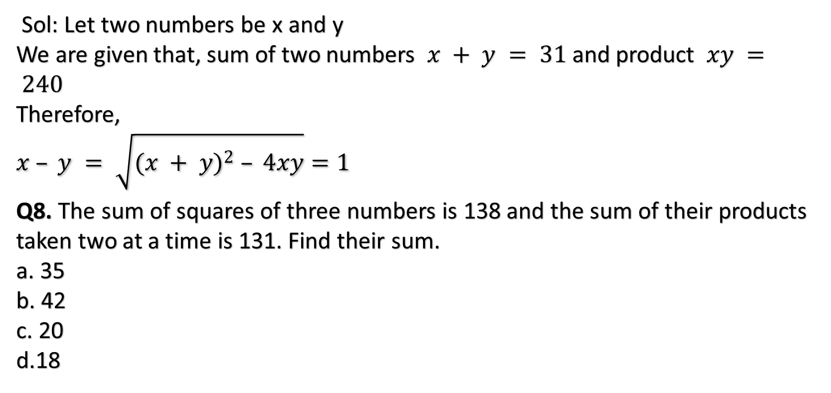
Number System (CO5)
Sol: Let two numbers be x and y We are given that, sum of two numbers $x + y = 31$and product $xy = 240$ Therefore, $$x – y = \sqrt{{(x + y)}^{2} – 4xy}=1$$
Q8. The sum of squares of three numbers is 138 and the sum of their products taken two at a time is 131. Find their sum. a. 35 b. 42 c. 20 d.18

Slide 37
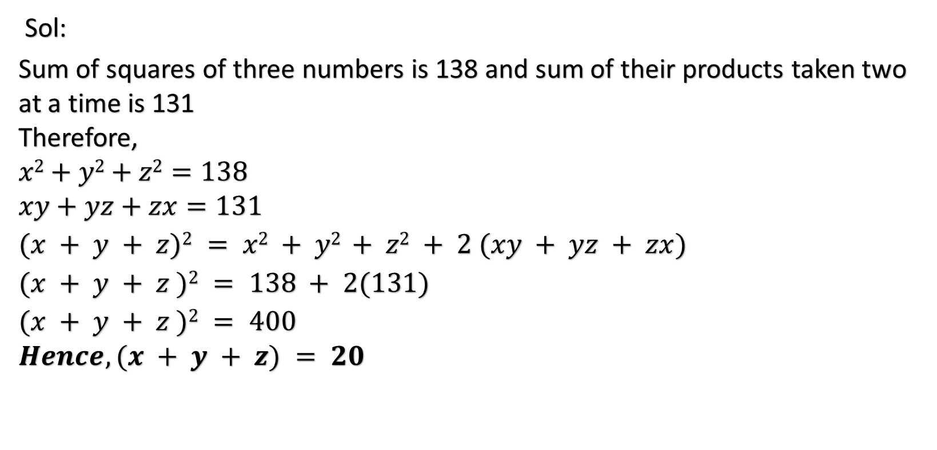
Number System (CO5)
Sol:
Sum of squares of three numbers is 138 and sum of their products taken two at a time is 131 Therefore, $$x2+y2+z2=138 \\ xy+yz+zx=131$$
$$(x + y + z)2 = x2 + y2 + z2 + 2 (xy + yz + zx) \\ (x + y + z )2 = 138 + 2(131) \\ (x + y + z )2 = 400 \\ Hence, (x + y + z) = 20$$

Slide 38
Number System (CO5)
Q9. Find the largest number of 4-digits divisible by 12, 15 and 18. a. 9900 b. 9750 c. 9450 d. 9000
Sol: L.C.M. of 12, 15 and 18 12 = 2 × 2 × 3 15 =5 × 3 18 = 2 × 3 × 3 L.C.M. = 180 Now divide 9999 by 180, we get remainder as 99 The required largest number = (9999 – 99) =9900 Number 9900 is exactly divisible by 180.

Slide 39
Recap(CO5)
Number System

Slide 40
Topic objective (CO5)
Understand the concept of arrangement & Combination by permutation & combination.
Understand the concept of basic probability.

Slide 41
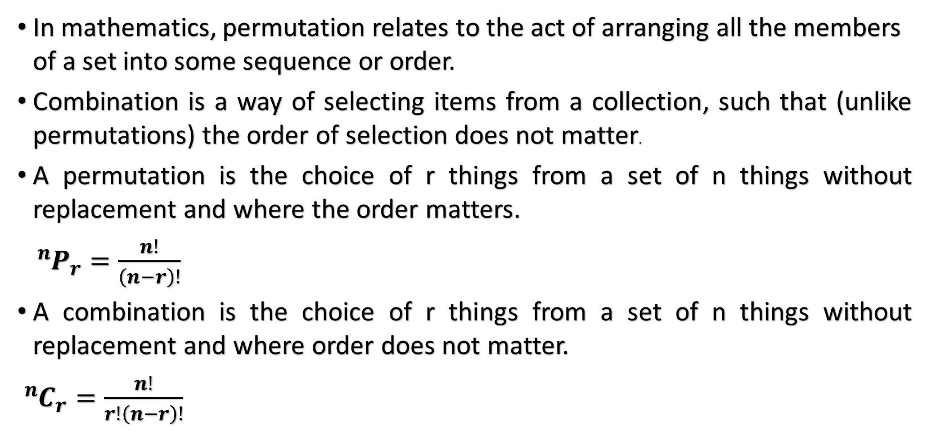
Permutation & Combination (CO5)
In mathematics, permutation relates to the act of arranging all the members of a set into some sequence or order.
Combination is a way of selecting items from a collection, such that (unlike permutations) the order of selection does not matter.
A permutation is the choice of r things from a set of n things without replacement and where the order matters.
${}_{ }^{n}{P_{r}=\frac{n!}{\left(n−r\right)!}}$
A combination is the choice of r things from a set of n things without replacement and where order does not matter.
${}_{ }^{n}{C_{r}=\frac{n!}{r!\left(n−r\right)!}}$

Slide 42
Permutation & Combination (CO5)
Difference Between Permutation and Combination:
Permutation | Combination
Arranging people, digits, numbers, alphabets, letters, and colours | Selection of menu, food, clothes, subjects, team.
Picking a team captain, pitcher and shortstop from a group. | Picking three team members from a group.
Picking two favourite colours, in order, from a colour brochure. | Picking two colours from a colour brochure.
Picking first, second and third place winners. | Picking three winners.

Slide 43
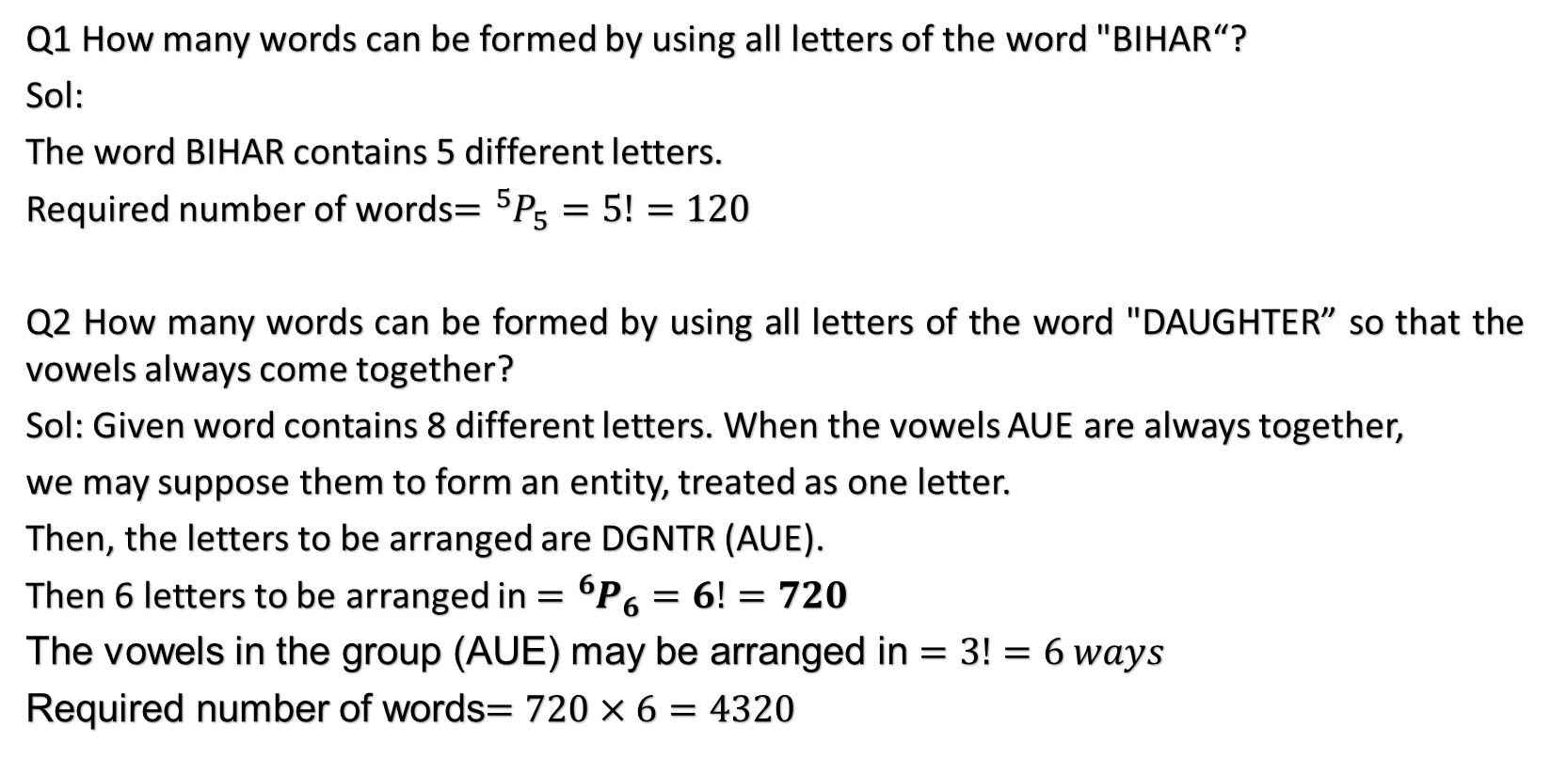
Permutation & Combination (CO5)
Q1 How many words can be formed by using all letters of the word "BIHAR“?
Sol:
The word BIHAR contains 5 different letters.
Required number of words$={}_{ }^{5}{P_{5}=}5!=120$
Q2 How many words can be formed by using all letters of the word "DAUGHTER” so that the vowels always come together?
Sol: Given word contains 8 different letters. When the vowels AUE are always together,
we may suppose them to form an entity, treated as one letter.
Then, the letters to be arranged are DGNTR (AUE).
Then 6 letters to be arranged in $={}_{ }^{6}{P_{6}=6!=720}$
The vowels in the group (AUE) may be arranged in $=3!=6 ways$
Required number of words$=720×6=4320$

Slide 44
Permutation & Combination (CO5)
Q3 How many words can be formed from the letters of the word "EXTRA" so that the vowels are never together?
Sol: The given word contains 5 different letters.
Taking the vowels EA together, we treat them as one letter.
Then, the letters to be arranged are XTR (EA).
These letters can be arranged in 4! = 24 ways.
The vowels EA may be arranged amongst themselves in 2! = 2 ways.
Number of words, each having vowels together = (24x2) = 48 ways.
Total number of words formed by using all the letters of the given words
= 5! = (5x4x3x2x1) = 120.
Number of words, each having vowels never together = (120-48) = 72.

Slide 45
Permutation & Combination (CO5)
Q4 How many words can be formed from the letters of the word "DIRECTOR“ So that the vowels are always together?
Sol: In the given word, we treat the vowels IEO as one letter.
Thus, we have DRCTR (IEO).
This group has 6 letters of which R occurs 2 times and others are different.
Number of ways of arranging these letters = 6!/2! = 360.
Now 3 vowels can be arranged among themselves in 3! = 6 ways.
Required number of ways = (360x6) = 2160

Slide 46
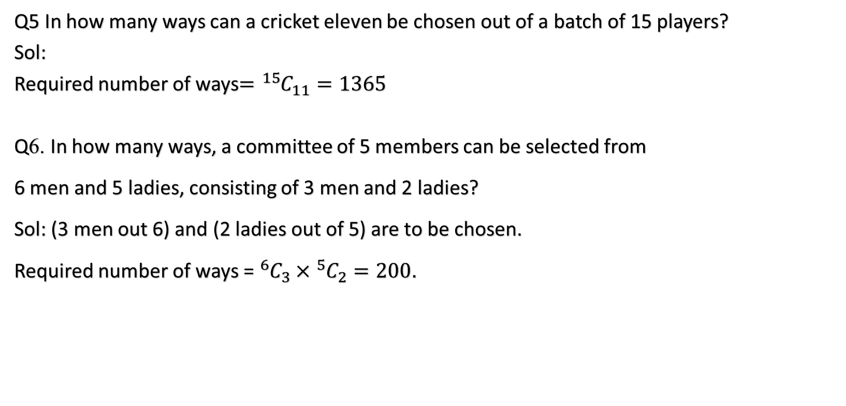
Permutation & Combination (CO5)
Q5 In how many ways can a cricket eleven be chosen out of a batch of 15 players?
Sol:
Required number of ways$={}_{ }^{15}{C_{11}=1365}$
Q6. In how many ways, a committee of 5 members can be selected from
6 men and 5 ladies, consisting of 3 men and 2 ladies?
Sol: (3 men out 6) and (2 ladies out of 5) are to be chosen.
Required number of ways =${}_{ }^{6}{C_{3}×{}_{ }^{5}{C_{2}}}=200$.

Slide 47
Probability (CO5)
Trial and events: The experiment is called trials and the possible outcomes are known as events or cases. For example-Tossing of a coin is a trial and the running up of the head or tail is an event.
Random Experiments: Whose results can not be predicated before hand is known as Random Experiments. For Example-Tossing a coin, Rolling a die, balls taking out from an urn.
Sample Space: The set of all possible outcomes of a random experiment is called Sample Space and it is denoted by S. Example- If we are tossing a coin then the outcomes are Head(H) and Tail(T). So sample space S={H,T}
Favorable events or cases: The total number of possible outcomes in which specified event happens then these specified events are known as Favorable event or cases. For example- In a throw of two dice , the number of cases favorable to getting a sum 6 is 5, i.e. (1,5);(2,4); (3,3);(4,2);(5,1)

Slide 48
Probability (CO5)
Mutually exclusive events: If no two or more than two of them can happen simultaneously in same trial. For example: In tossing a coin , then events are head and tail are mutually exclusive, since if the outcome is head then the possibility of getting tail in the same trial ruled out.
Equally likely events: Events are said to be equally likely if there is no reasons to expect any one in preference to any other. For example- In throwing a die ,all the six faces are equally likely to come.
Independent & dependent events: Two or more events are said to be independent if the happening or non happening of any one does depend (or is not affected) by the happening or non happening of any other . Otherwise they are said to be dependent

Slide 49
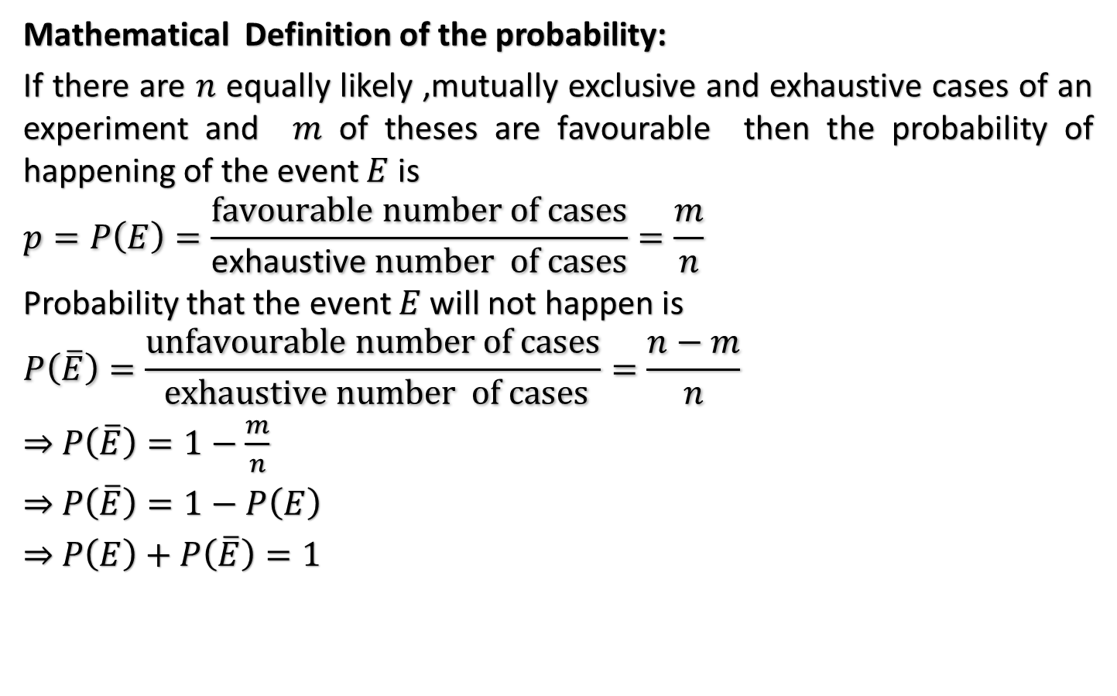
Probability (CO5)
Mathematical Definition of the probability:
If there are $n$ equally likely ,mutually exclusive and exhaustive cases of an experiment and $m$ of theses are favourable then the probability of happening of the event $E$ is
$$p=P\left(E\right)=\frac{favourable number of cases}{\text{exhaustive} number of cases}=\frac{m}{n}$$
Probability that the event $E$ will not happen is
$$P\left(\overline{E}\right)=\frac{unfavourable number of cases}{ exhaustive number of cases}=\frac{n−m}{n}$$
⇒ $P\left(\overline{E}\right)=1−\frac{m}{n}$
⇒ $P\left(\overline{E}\right)=1−P\left(E\right)$
⇒ $P\left(E\right)+P\left(\overline{E}\right)=1$

Slide 50

Probability (CO5)
Note:
Probability of the impossible event is zero.
$0≤P\left(E\right)≤1.$

Slide 51
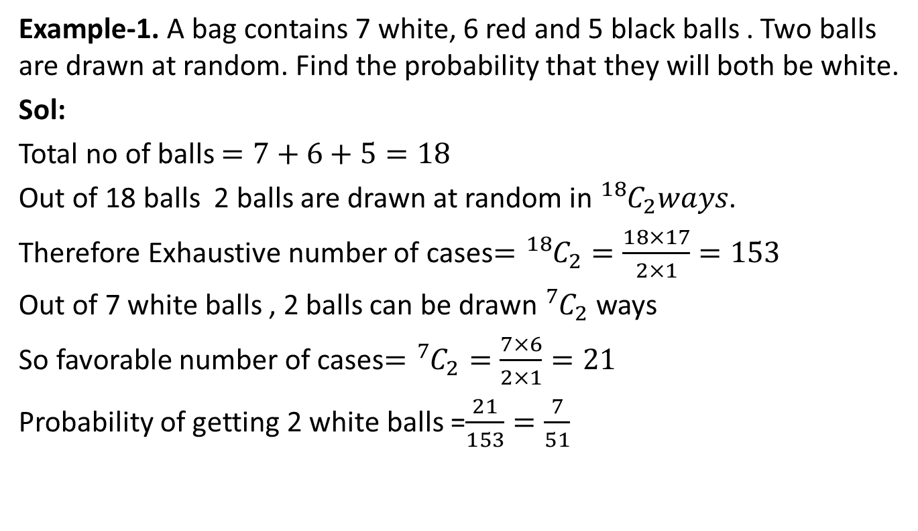
Probability (CO5)
Example-1. A bag contains 7 white, 6 red and 5 black balls . Two balls are drawn at random. Find the probability that they will both be white.
Sol:
Total no of balls $=7+6+5=18$
Out of 18 balls 2 balls are drawn at random in ${}_{ }^{18}{C_{2}}ways$.
Therefore Exhaustive number of cases$={}_{ }^{18}{C_{2}}=\frac{18×17}{2×1}=153$
Out of 7 white balls , 2 balls can be drawn ${}_{ }^{7}{C_{2}}$ways
So favorable number of cases$={}_{ }^{7}{C_{2}}=\frac{7×6}{2×1}=21$
Probability of getting 2 white balls =$\frac{21}{153}=\frac{7}{51}$

Slide 52
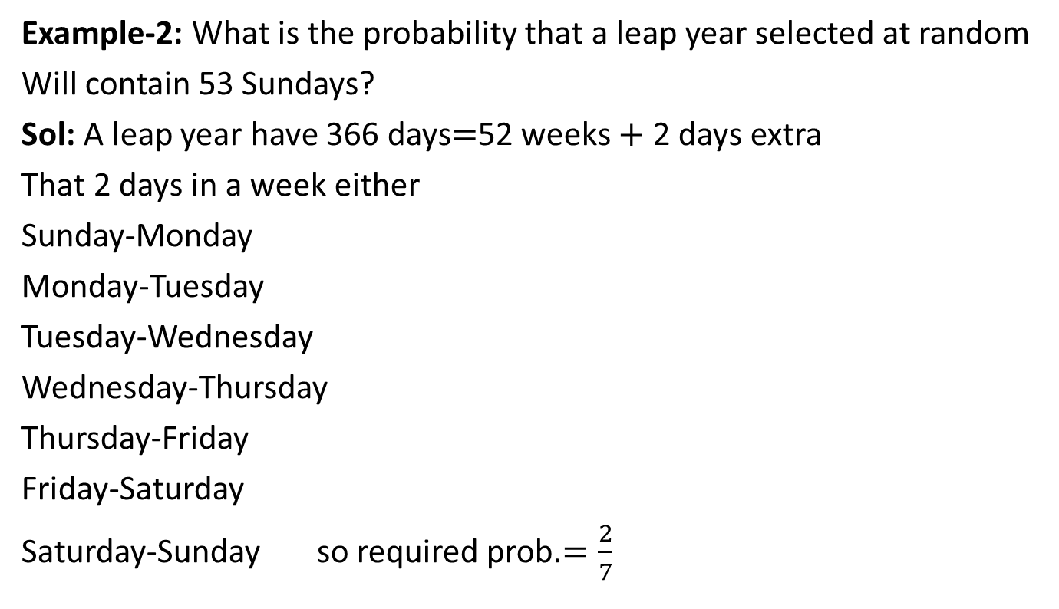
Probability (CO5)
Example-2: What is the probability that a leap year selected at random
Will contain 53 Sundays?
Sol: A leap year have 366 days$=$52 weeks $+$ 2 days extra
That 2 days in a week either
Sunday-Monday
Monday-Tuesday
Tuesday-Wednesday
Wednesday-Thursday
Thursday-Friday
Friday-Saturday
Saturday-Sunday so required prob.$=\frac{2}{7}$

Slide 53
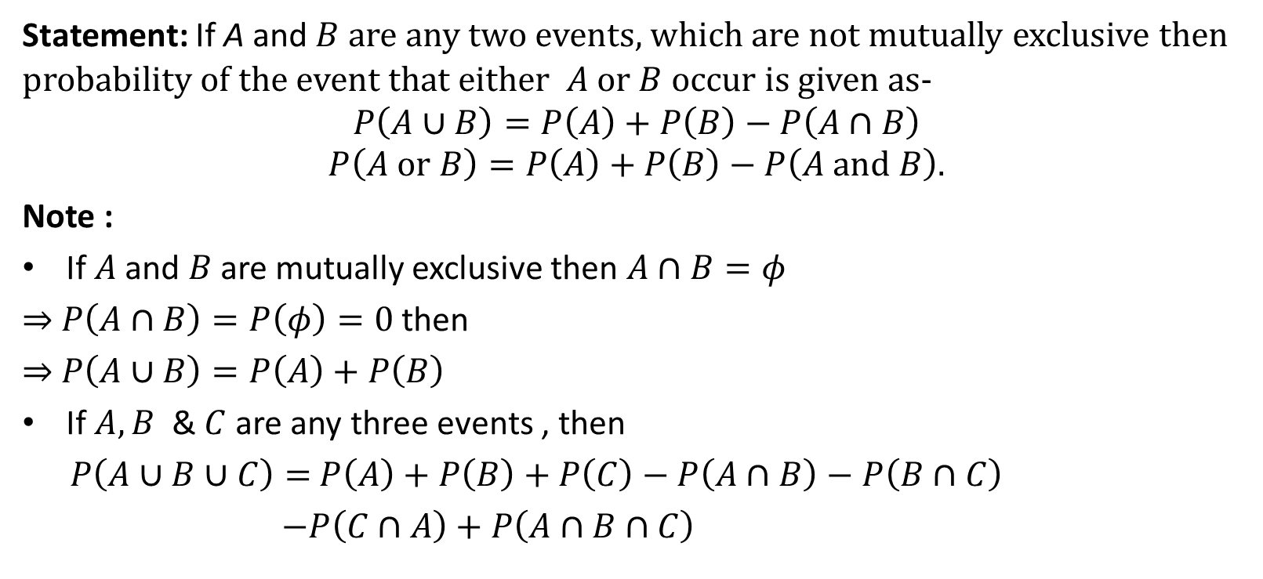
Addition Law of Probability (CO5)
Statement: If A and $B$ are any two events, which are not mutually exclusive then probability of the event that either $A$ or $B$ occur is given as-
$$P\left(A∪B\right)=P\left(A\right)+P\left(B\right)−P\left(A∩B\right)$$
$$P\left(A or B\right)=P\left(A\right)+P\left(B\right)−P\left(A and B\right).$$
Note :
If $A$ and $B$ are mutually exclusive then $A∩B=φ$
⇒ $P\left(A∩B\right)=P\left(φ\right)=0$ then
⇒ $P\left(A∪B\right)=P\left(A\right)+P\left(B\right)$
If $A,B$&$C$ are any three events , then
$P\left(A∪B∪C\right)=$$P\left(A\right)+P\left(B\right)+P\left(C\right)−P\left(A∩B\right)−$$P\left(B∩C\right)$
$−P\left(C∩A\right)+P\left(A∩B∩C\right)$

Slide 54
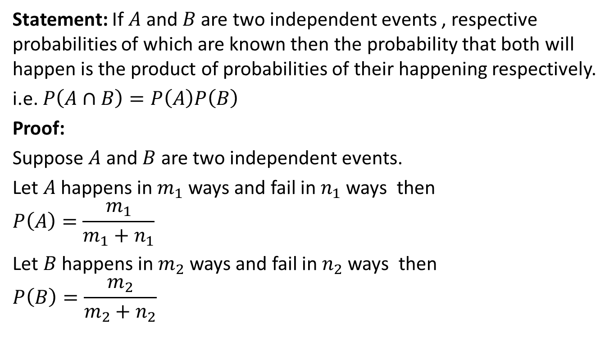
Multiplicative Law of Probability (CO5)
Statement: If $A$ and $B$ are two independent events , respective probabilities of which are known then the probability that both will happen is the product of probabilities of their happening respectively.
i.e. $P\left(A∩B\right)=P\left(A\right)P\left(B\right)$
Proof:
Suppose $A$ and $B$ are two independent events.
Let $A$ happens in $m_{1}$ ways and fail in $n_{1}$ ways then
$$P\left(A\right)=\frac{m_{1}}{m_{1}+n_{1}}$$
Let $B$ happens in $m_{2}$ ways and fail in $n_{2}$ ways then
$$P\left(B\right)=\frac{m_{2}}{m_{2}+n_{2}}$$

Slide 55
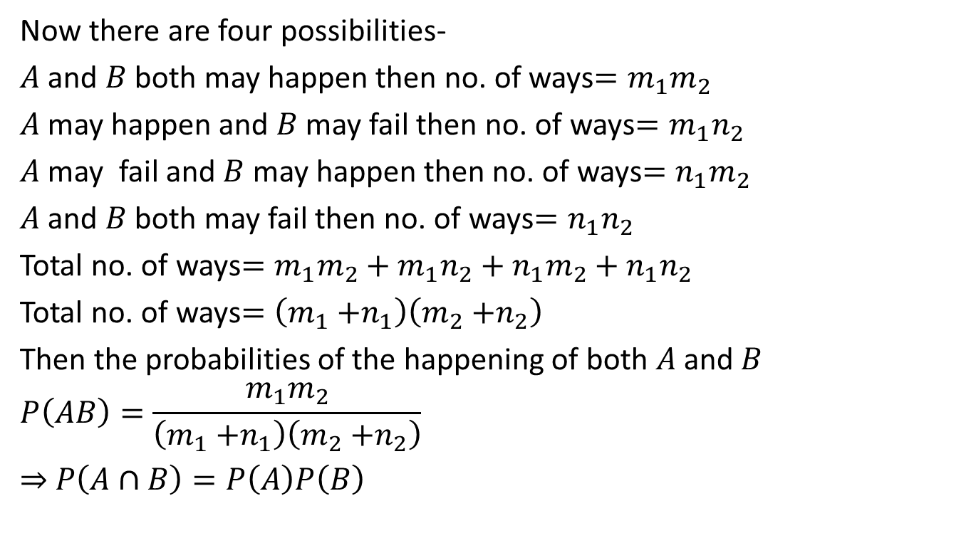
Multiplicative Law of Probability (CO5)
Now there are four possibilities-
$A$ and $B$ both may happen then no. of ways$=m_{1}m_{2}$
$A$ may happen and $B$ may fail then no. of ways$=m_{1}n_{2}$
$A$ may fail and $B$ may happen then no. of ways$=n_{1}m_{2}$
$A$ and $B$ both may fail then no. of ways$=n_{1}n_{2}$
Total no. of ways$=m_{1}m_{2}+m_{1}n_{2}+n_{1}m_{2}+n_{1}n_{2}$
Total no. of ways$=\left(m_{1}{+n}_{1}\right)\left(m_{2}{+n}_{2}\right)$
Then the probabilities of the happening of both $A$ and $B$
$$P\left(AB\right)=\frac{m_{1}m_{2}}{\left(m_{1}{+n}_{1}\right)\left(m_{2}{+n}_{2}\right)}$$
⇒ $P\left(A∩B\right)=P\left(A\right)P\left(B\right)$

Slide 56
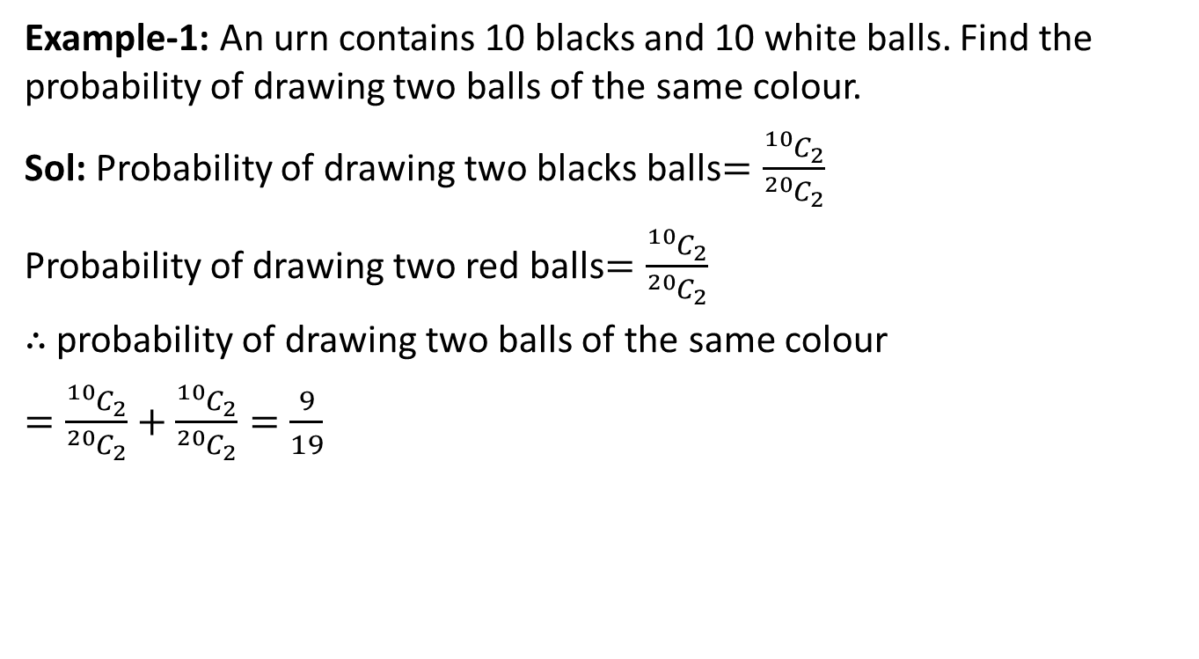
Addition Law of Probability (CO5)
Example-1: An urn contains 10 blacks and 10 white balls. Find the probability of drawing two balls of the same colour.
Sol: Probability of drawing two blacks balls$=\frac{{}_{ }^{10}{C_{2}}}{{}_{ }^{20}{C_{2}}}$
Probability of drawing two red balls$=\frac{{}_{ }^{10}{C_{2}}}{{}_{ }^{20}{C_{2}}}$
$∴$ probability of drawing two balls of the same colour
$=\frac{{}_{ }^{10}{C_{2}}}{{}_{ }^{20}{C_{2}}}+\frac{{}_{ }^{10}{C_{2}}}{{}_{ }^{20}{C_{2}}}=\frac{9}{19}$

Slide 57
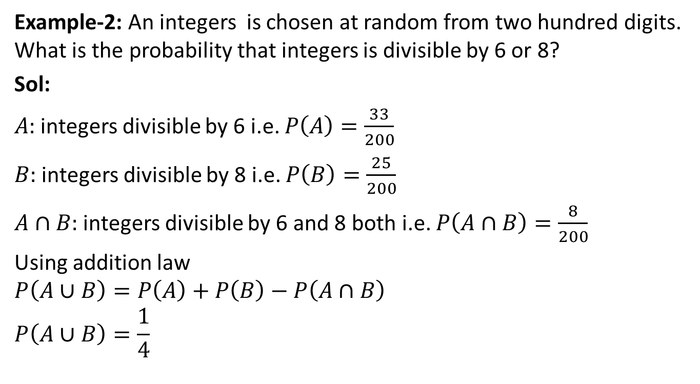
Addition Law of Probability (CO5)
Example-2: An integers is chosen at random from two hundred digits. What is the probability that integers is divisible by 6 or 8?
Sol:
$A:$ integers divisible by 6 i.e. $P\left(A\right)=\frac{33}{200}$
$B:$ integers divisible by 8 i.e. $P\left(B\right)=\frac{25}{200}$
$A∩B:$ integers divisible by 6 and 8 both i.e. $P\left(A∩B\right)=\frac{8}{200}$
Using addition law
$$P\left(A∪B\right)=P\left(A\right)+P\left(B\right)−P\left(A∩B\right)$$
$$P\left(A∪B\right)=\frac{1}{4}$$

Slide 58
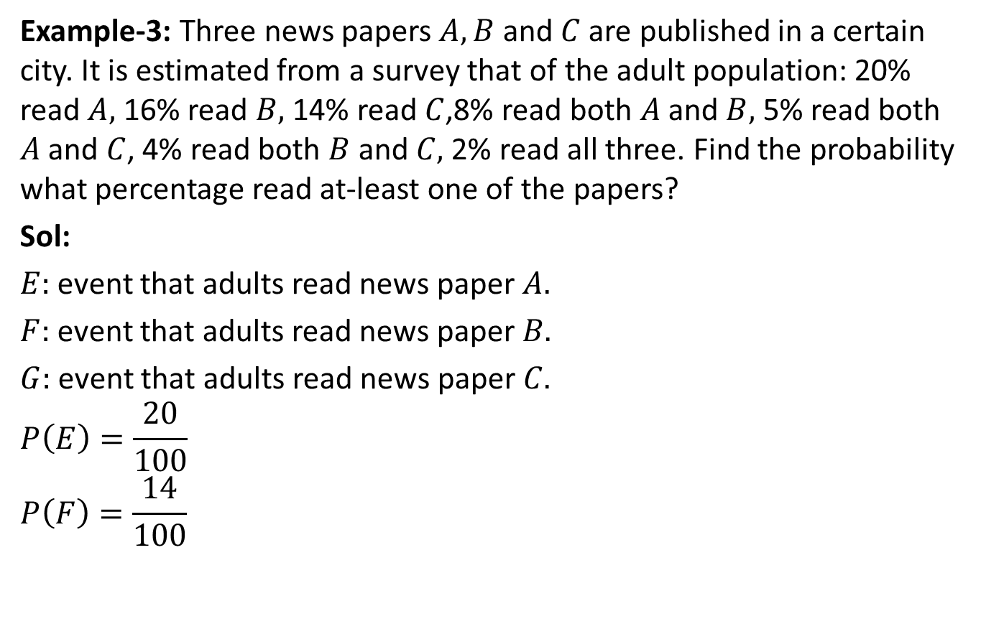
Addition Law of Probability (CO5)
Example-3: Three news papers $A,B$ and $C$ are published in a certain city. It is estimated from a survey that of the adult population: 20% read $A,$ 16% read $B,$ 14% read $C$,8% read both $A$ and $B,$ 5% read both $A$ and $C$, 4% read both $B$ and $C,$ 2% read all three. Find the probability what percentage read at-least one of the papers?
Sol:
$E:$ event that adults read news paper $A.$
$F:$ event that adults read news paper $B.$
$G:$ event that adults read news paper $C.$
$$P\left(E\right)=\frac{20}{100}$$
$$P\left(F\right)=\frac{14}{100}$$

Slide 59
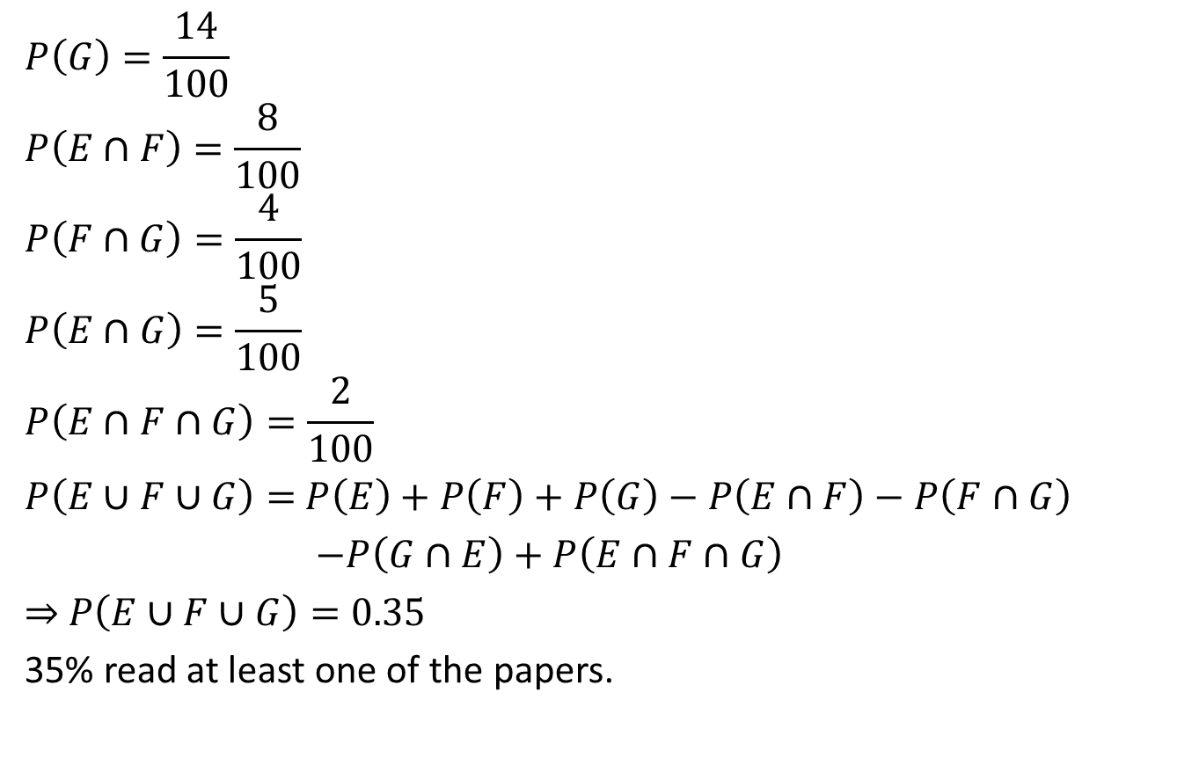
Addition Law of Probability (CO5)
$$P\left(G\right)=\frac{14}{100}$$
$$P\left(E∩F\right)=\frac{8}{100}$$
$$P\left(F∩G\right)=\frac{4}{100}$$
$$P\left(E∩G\right)=\frac{5}{100}$$
$$P\left(E∩F∩G\right)=\frac{2}{100}$$
$P\left(E∪F∪G\right)=$$P\left(E\right)+P\left(F\right)+P\left(G\right)−P\left(E∩F\right)−$$P\left(F∩G\right)$
$−P\left(G∩E\right)+P\left(E∩F∩G\right)$
⇒ $P\left(E∪F∪G\right)=0.35$
35% read at least one of the papers.

Slide 60
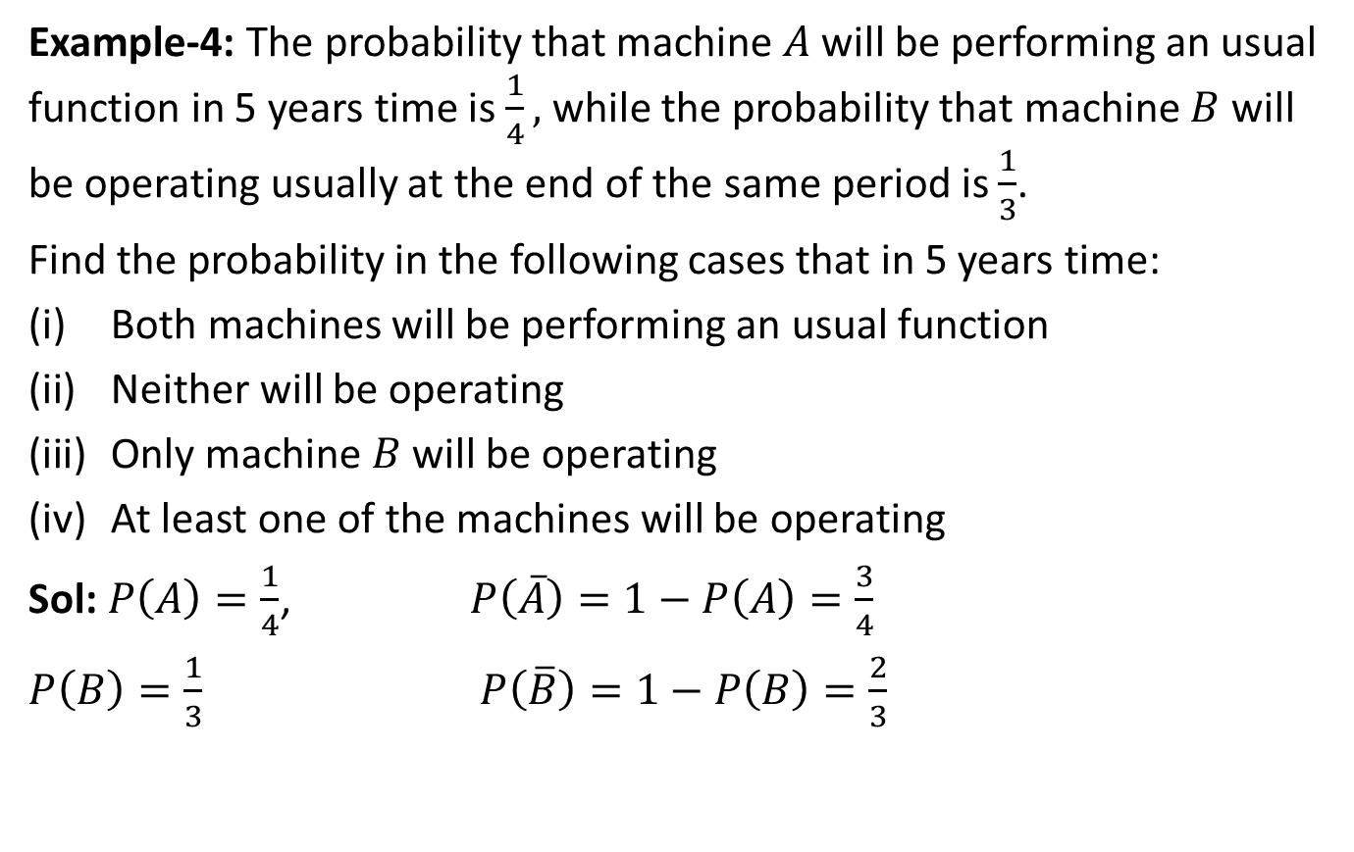
Multiplicative Law of Probability (CO5)
Example-4: The probability that machine $A$ will be performing an usual function in 5 years time is $\frac{1}{4},$ while the probability that machine $B$ will be operating usually at the end of the same period is $\frac{1}{3}$.
Find the probability in the following cases that in 5 years time:
Both machines will be performing an usual function
Neither will be operating
Only machine $B$ will be operating
At least one of the machines will be operating
Sol: $P\left(A\right)=\frac{1}{4}$, $P\left(\overline{A}\right)=1−P\left(A\right)=\frac{3}{4}$
$P\left(B\right)=\frac{1}{3}$$P\left(\overline{B}\right)=1−P\left(B\right)=\frac{2}{3}$

Slide 61

Multiplicative Law of Probability (CO5)
$P\left(AB\right)=P\left(A\right).P\left(B\right)=\frac{1}{12}$
$P\left(\overline{A}\overline{B}\right)=\frac{1}{2}$
$P\left(\overline{A}B\right)=\frac{1}{4}$
Required prob$=P\left(\overline{A}B\right)+$$P\left(\overline{A}B\right)+ P\left(AB\right)=\frac{1}{2}$

Slide 62

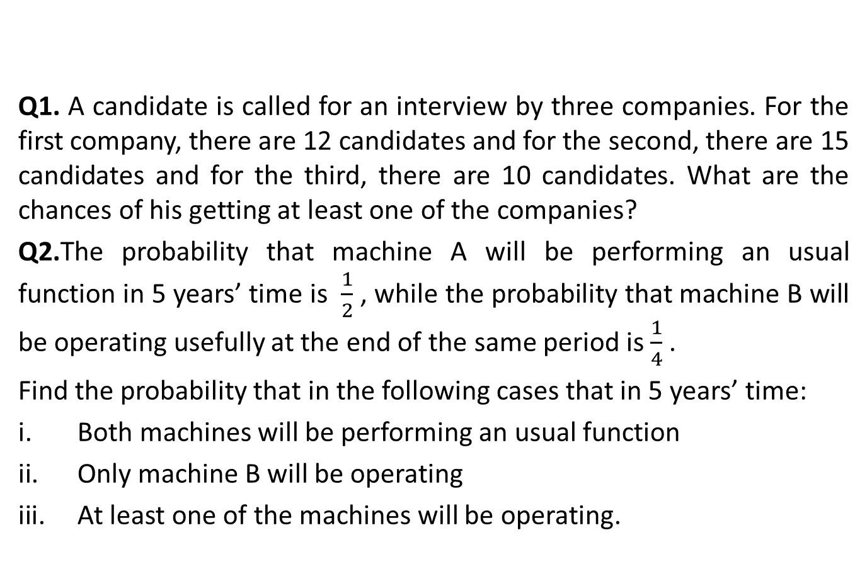
Probability (CO5)
Q1. A candidate is called for an interview by three companies. For the first company, there are 12 candidates and for the second, there are 15 candidates and for the third, there are 10 candidates. What are the chances of his getting at least one of the companies?
Q2.The probability that machine A will be performing an usual function in 5 years’ time is $\frac{1}{2}$ , while the probability that machine B will be operating usefully at the end of the same period is $\frac{1}{4}$ .
Find the probability that in the following cases that in 5 years’ time:
Both machines will be performing an usual function
Only machine B will be operating
At least one of the machines will be operating.

Slide 63
Recap(CO5)
Number System
Permutation & Combination
Probability

Slide 64
Topic objective (CO5)
Understand the concept of Function & its various types.

Slide 65
Function (CO5)
Function: Let A & B be any two non-empty sets, mapping from A to B will be a function only when every element in set A has one end only one image in set B.

Slide 66
Function (CO5)
Vertical Line Test:
Vertical line test is used to determine whether a curve is a function or not. If any curve cuts a vertical line at more than one points then the curve is not a function.

Slide 67
Function (CO5)
Types of Functions:
One – one function (Injective function)
Many – one function
Onto – function (Surjective Function)
Into – function

Slide 68

Function (CO5)
One – one function (Injective function)
If each element in the domain of a function has a distinct image in the co-domain, the function is said to be one – one function.
For example: $If f:R→R$ given by $f\left(x\right)=3x+5$ is one-one function.

Slide 69

Function (CO5)
Many – one function:
On the other hand, if there are at least two elements in the domain whose images are same, the function is known as many to one.
For example: If $f:R→R$ given by $f\left(x\right)=x^{2}+1$ is many one function.

Slide 70
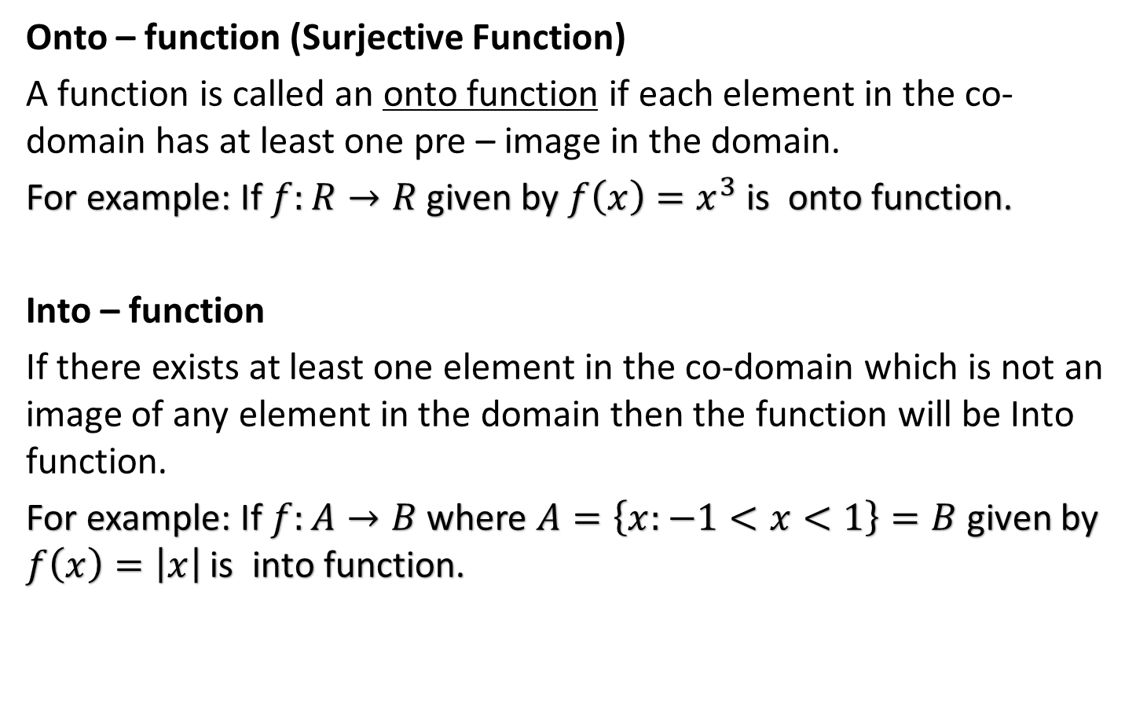
Function (CO5)
Onto – function (Surjective Function)
A function is called an onto function if each element in the co-domain has at least one pre – image in the domain.
For example: If $f:R→R$ given by $f\left(x\right)=x^{3}$ is onto function.
Into – function
If there exists at least one element in the co-domain which is not an image of any element in the domain then the function will be Into function.
For example: If $f:A→B$ where $A=\left\{x:−1<x<1\right\}=B$ given by $f\left(x\right)=\left|x\right|$ is into function.

Slide 71
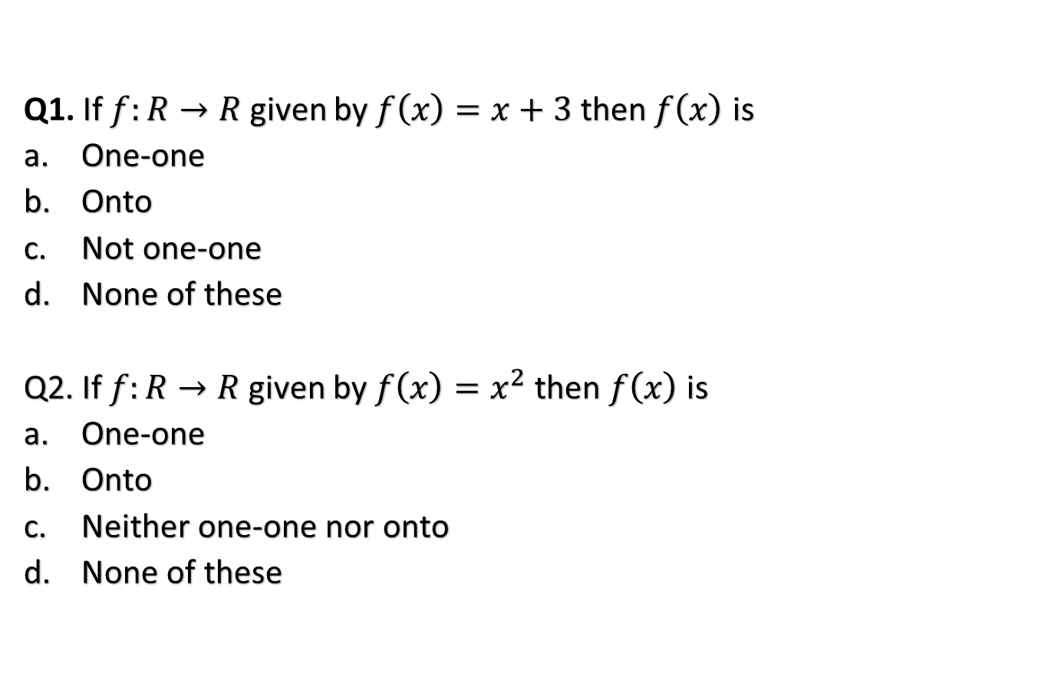
Function (CO5)
Q1. If $f:R→R$ given by $f\left(x\right)=x+3$ then $f\left(x\right)$ is
One-one
Onto
Not one-one
None of these
Q2. If $f:R→R$ given by $f\left(x\right)=x^{2}$ then $f\left(x\right)$ is
One-one
Onto
Neither one-one nor onto
None of these

Slide 72
Topic objective (CO5)
Understand the concept of Data Interpretation & Syllogism.

Slide 73
Data Interpretation (CO5)
Data Interpretation or DI: refers to the implementation of procedures through which data is reviewed for the purpose of arriving at an inference. Data can be obtained from multiple sources e.g. data from running of industries, census population data etc. Interpreting data requires analyzing data to infer information from it in order to answer questions. Data can be provided in a number of formats via: Bars, tables, line graphs, pie graphs.
Bar Graph: A bar graph or bar chart represents explicit data with rectangular bars. The heights and lengths of these bar graphs are proportional to the values of data they represent. There are two types of bar graph, one is called horizontal bar graph and other is called vertical bar graph. Bar graphs made up of two axis, one is called x- axis and other is called y- axis.

Slide 74
Data Interpretation (CO5)
What is represented in a Data Interpretation Table?
DI Questions based on Tables are very common in competitive exams. Rows and Columns of tables consist of various types of data like income of company, expenditure on various items, and marks of Applicants and so on. First column and row of tables represent the titles. Level of Questions in Tables may be lower or higher in comparison of other graphs form, depending on given data in the table and the way, questions are framed.

Slide 75
Data Interpretation (CO5)
Data Interpretation Forms:-
As every one of you know Data can be composed or spoke to in 4 Forms
1. Numerical: - Data in numerical structure
2. Table Form: - Data in Tabular structure
3. Mixed form: - Data in Mix Form
4. Graphical structure Like Line, Bar chart and so forth.

Slide 76
Data Interpretation (CO5)
Tabular Data Interpretation formulas
1. Average:
Average =total of data/ No.of data
2. Percentage:
If we have to find y% of x, then
y% of x=(x*y)/100
3. Ratio & Proportion:
The ratio of a to b is written as a: b = a / b
The idea of proportions is that two ratio are equal. If a: b = c: d, we write a: b::c: d

Slide 77
Data Interpretation (CO5)
Example-1
Directions (1 -5):

Slide 78
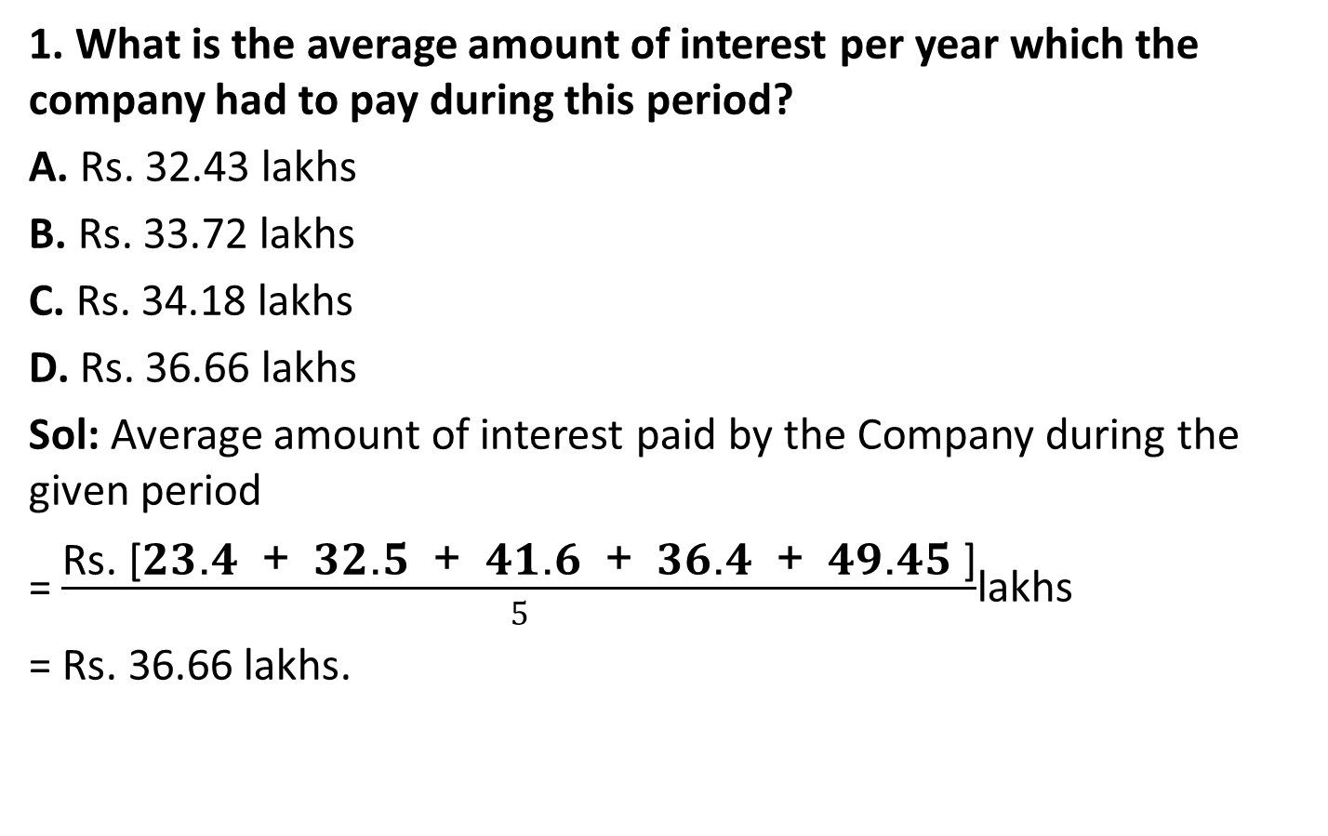
Data Interpretation (CO5)
1. What is the average amount of interest per year which the company had to pay during this period?
A. Rs. 32.43 lakhs
B. Rs. 33.72 lakhs
C. Rs. 34.18 lakhs
D. Rs. 36.66 lakhs
Sol: Average amount of interest paid by the Company during the given period
= $\frac{\text{Rs}\text{. [}\text{23}\text{.}\text{4}\text{ + }\text{32}\text{.}\text{5}\text{ + }\text{41}\text{.}\text{6}\text{ + }\text{36}\text{.}\text{4}\text{ + }\text{49}\text{.}\text{45} \text{]}}{5}$lakhs
= Rs. 36.66 lakhs.

Slide 79
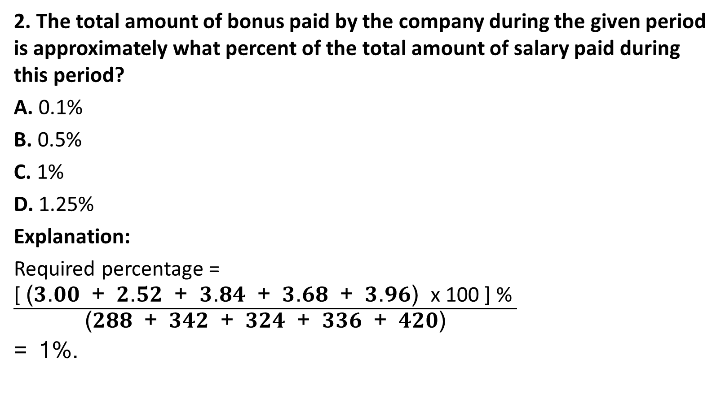
Data Interpretation (CO5)
2. The total amount of bonus paid by the company during the given period is approximately what percent of the total amount of salary paid during this period?
A. 0.1%
B. 0.5%
C. 1%
D. 1.25%
Explanation:
Required percentage = $\frac{\text{[ }\text{(}\text{3}\text{.}\text{00}\text{ + }\text{2}\text{.}\text{52}\text{ + }\text{3}\text{.}\text{84}\text{ + }\text{3}\text{.}\text{68}\text{ + }\text{3}\text{.}\text{96}\text{) }\text{x}\text{ 100 ] \% }}{\text{(}\text{288}\text{ + }\text{342}\text{ + }\text{324}\text{ + }\text{336}\text{ + }\text{420}\text{)}}$
= 1%.

Slide 80
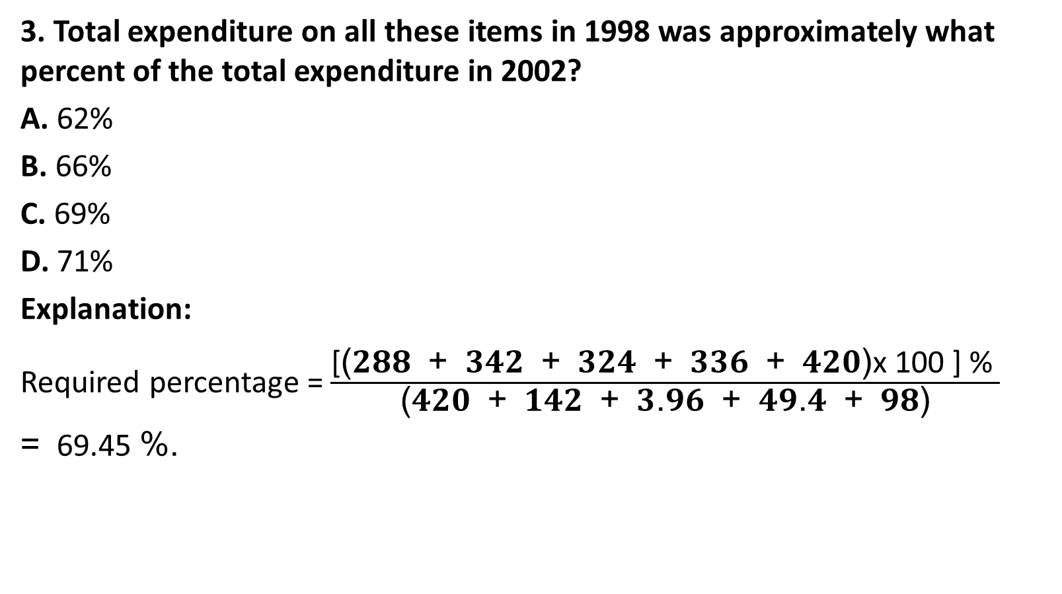
Data Interpretation (CO5)
3. Total expenditure on all these items in 1998 was approximately what percent of the total expenditure in 2002?
A. 62%
B. 66%
C. 69%
D. 71%
Explanation:
Required percentage = $\frac{\text{[}\text{(}\text{288}\text{ + }\text{342}\text{ + }\text{324}\text{ + }\text{336}\text{ + }\text{420}\text{)}\text{x}\text{ 100 ] \% }}{\text{(}\text{420}\text{ + }\text{142}\text{ + }\text{3}\text{.}\text{96}\text{ + }\text{49}\text{.}\text{4}\text{ + }\text{98}\text{)}}$
= 69.45 %.

Slide 81
Data Interpretation (CO5)
4. The total expenditure of the company over these items during the year 2000 is?
A. Rs. 544.44 lakhs
B. Rs. 501.11 lakhs
C. Rs. 446.46 lakhs
D. Rs. 478.87 lakhs
Explanation:
Total expenditure of the Company during 2000
= Rs. (324 + 101 + 3.84 + 41.6 + 74) lakhs
= Rs. 544.44 lakhs.

Slide 82
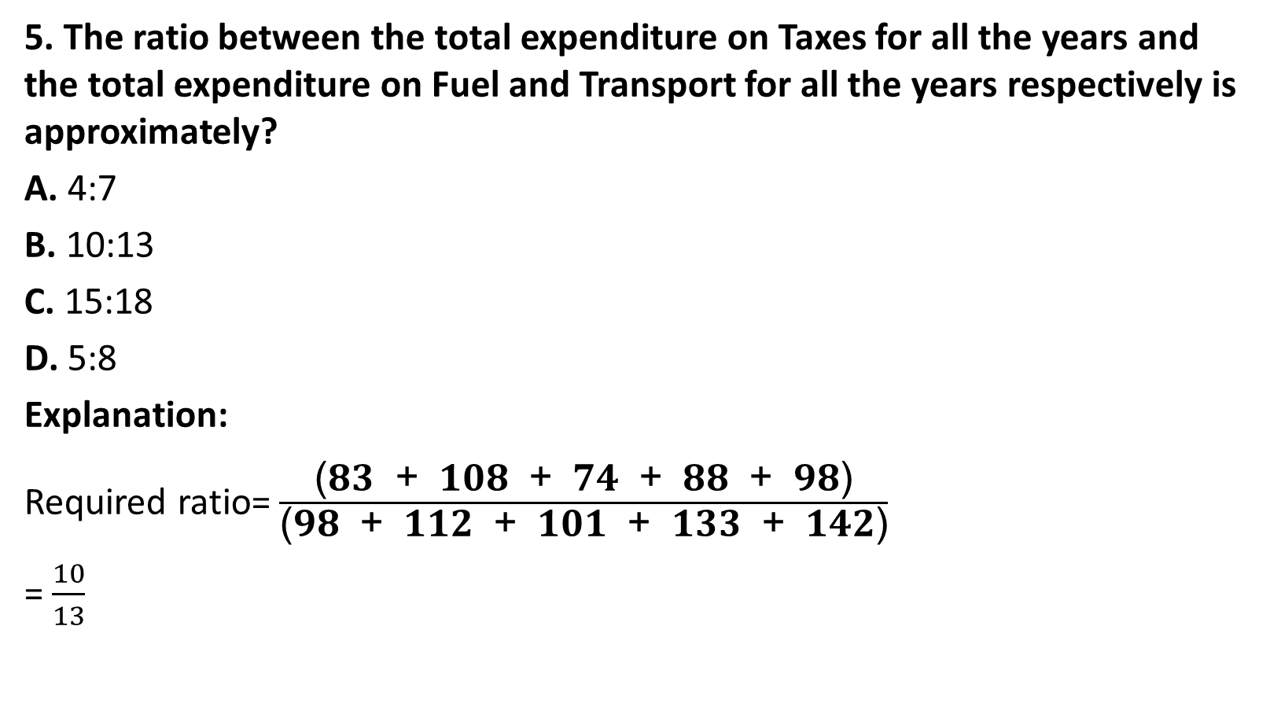
Data Interpretation (CO5)
5. The ratio between the total expenditure on Taxes for all the years and the total expenditure on Fuel and Transport for all the years respectively is approximately?
A. 4:7
B. 10:13
C. 15:18
D. 5:8
Explanation:
Required ratio= $\frac{\text{(}\text{83}\text{ + }\text{108}\text{ + }\text{74}\text{ + }\text{88}\text{ + }\text{98}\text{)}}{\text{(}\text{98}\text{ + }\text{112}\text{ + }\text{101}\text{ + }\text{133}\text{ + }\text{142}\text{)}}$
= $\frac{10}{13}$

Slide 83
Data Interpretation (CO5)
Example:2
Directions (1-5): The following pie-chart shows the number of students who failed in different subjects in an examination, Examine the chart and answer the following questions. The total number of students who have failed in 500.

Slide 84
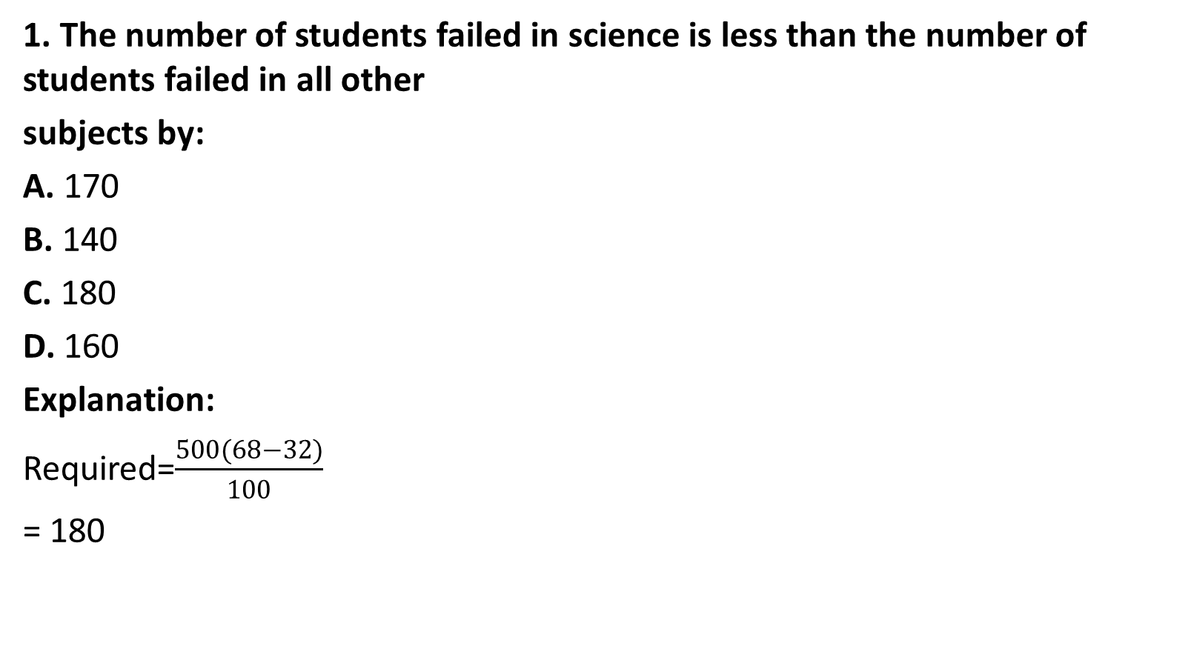
Data Interpretation (CO5)
1. The number of students failed in science is less than the number of students failed in all other
subjects by:
A. 170
B. 140
C. 180
D. 160
Explanation:
Required=$\frac{500(68−32)}{100}$
= 180

Slide 85

Data Interpretation (CO5)
2. The central angle of the sector for the students who have failed in mathematics is:
A. 30°
B. 100°
C. 105.2°
D. 108°
Explanation:
Required=$\frac{30}{100}×360$
=108

Slide 86
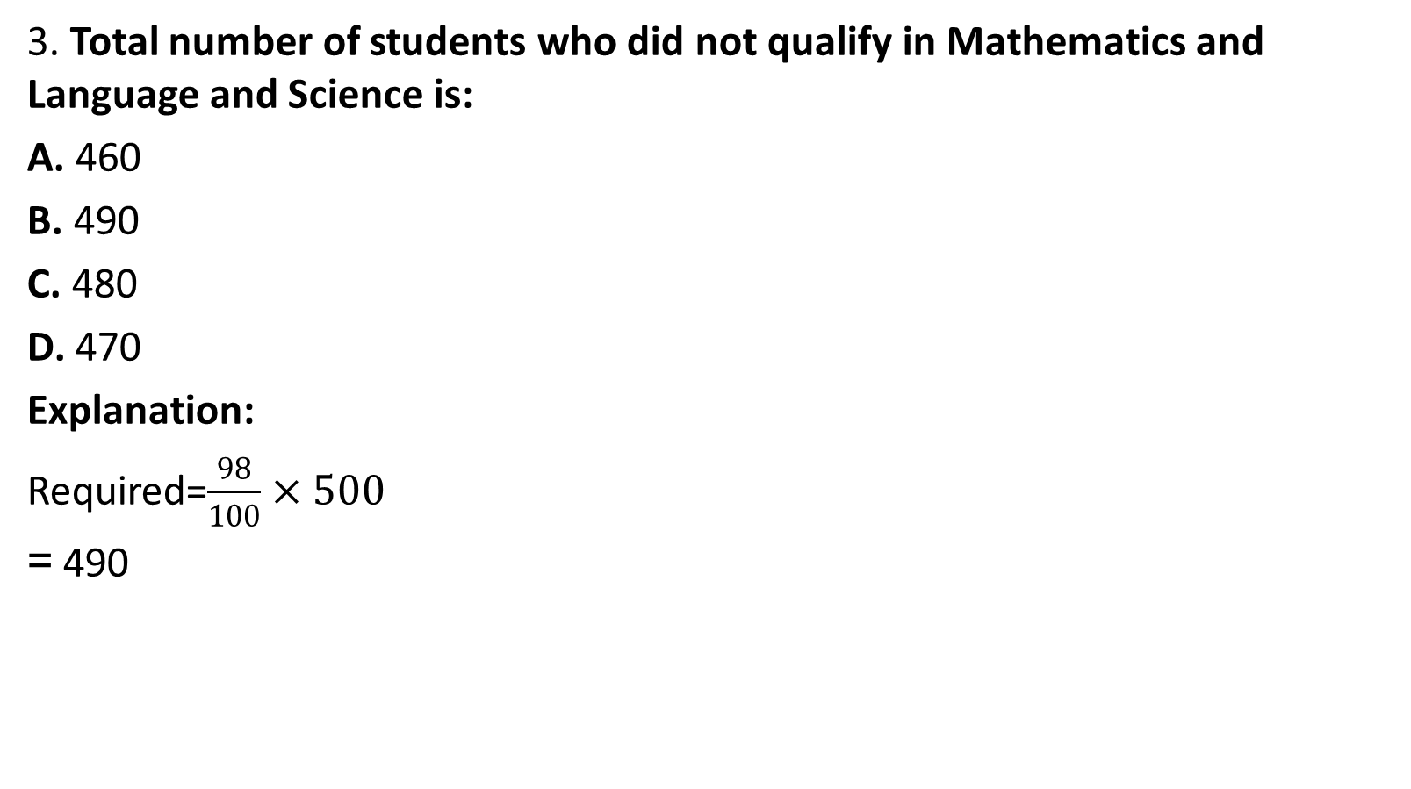
Data Interpretation (CO5)
3. Total number of students who did not qualify in Mathematics and Language and Science is:
A. 460
B. 490
C. 480
D. 470
Explanation:
Required=$\frac{98}{100}×500$
= 490

Slide 87
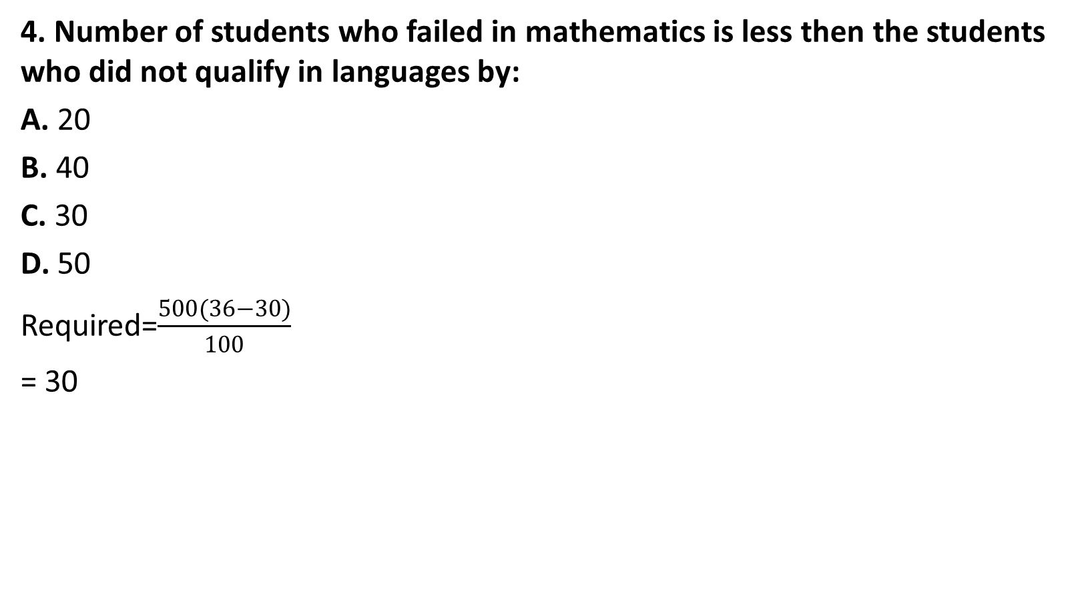
Data Interpretation (CO5)
4. Number of students who failed in mathematics is less then the students who did not qualify in languages by:
A. 20
B. 40
C. 30
D. 50
Required=$\frac{500(36−30)}{100}$
= 30

Slide 88
Data Interpretation (CO5)
5. The percentage of students who have failed in mathematics and language is:
A. 65.5%
B. 60%
C. 66%
D. 62%
Explanation:
Required percentage=(36 + 30) = 66%

Slide 89
Recap(CO2)
Number System
Permutation & Combination
Probability
Function
Data Interpretation

Slide 90
Syllogism (CO5)
Introduction:
The questions which are asked in this section contain two or more statements and these statements are followed by two or more conclusions. You have to find out which of the conclusions logically follow from the given statements. The statements have to be taken true even if they seem to be at variance from the commonly known facts.
For such questions, you can take the help of Venn Diagrams. On the basis of the given statements, you should draw all the possible diagrams, and then derive the solution from each of these diagrams separately. Finally, the answer common to the all the diagrams is taken.

Slide 91
Syllogism (CO5)
Example 1:
Statements:
All dogs are asses.
All asses are bulls.
Conclusions:
Some dogs are not bulls.
Some bulls are dogs.
All bulls are dogs.
All dogs are bulls.

Slide 92
Syllogism (CO5)
Solution:
On the basis of both statements, the following one diagram is possible.
From the diagram it is clear that (2) and (4) conclusions logically follow.

Slide 93
Syllogism (CO5)
Example:2
Statements:
Some actors are singers.
All the singers are dancers.
Conclusions:
Some actors are dancers.
No singer is actor.
Then
Only (1) conclusion follows
Only (2) conclusion follows
Either (1) or (2) follows
Neither (1) nor (2) follows

Slide 94
Syllogism (CO5)
Sol:
Only 1 follows

Slide 95
Syllogism (CO5)
Example:3
Statements:
No door is dog.
All the dogs are cats.
Conclusions:
No door is cat.
No cat is door.
Some cats are dogs.
All the cats are dogs.
Then
Only (2) and (4)
Only (1) and (3)
Only (3) and (4)
Only (3)

Slide 96
Syllogism (CO5)
Sol:
Only 3 follows

Slide 97
Syllogism (CO5)
Example-4
Statements: All the locks are keys. All the keys are bats. Some watches are bats.
Conclusions:
Some bats are locks.
Some watches are keys.
All the keys are locks.
Then
Only (1) and (2)
Only (1)
Only (2)
Only (1) and Only (3)

Slide 98
Syllogism (CO5)
Sol:

Slide 99

Syllogism (CO5)
Statements:
Some ants are parrots.
All the parrots are apples
Conclusions:
All the apples are parrots.
Some ants are apples.
Then
Only (1) conclusion follows
Only (2) conclusion follows
Neither (1) nor (2) follows
Both (1) and (2) follow

Slide 100
Recap(CO5)
Number System
Permutation & Combination
Probability
Function
Data Interpretation
Syllogism

Slide 101
Faculty Video Links, Youtube & NPTEL Video Links and Online Courses Details
Self Made Video Link:

Slide 102
Faculty Video Links, Youtube & NPTEL Video Links and Online Courses Details(CO5)
Suggested video link:
Number System
https://youtu.be/XBQXX-nFzr0
Permutation & Combination
https://youtu.be/ETiRE7N7pEI
Probability
https://youtu.be/CBnGs9t6RxY
Data Interpretation
https://youtu.be/oI1rowcZCeA
Syllogism
https://youtu.be/Ai7qmZIGILE

Slide 103
Weekly assignment (CO5)
Q1 Find the unit digit of (4137)⁷⁵⁴
Q2 Find which of the following number is divisible by 11?
Q3. Find the largest 4 digit number which is divisible by 88. Q4. The remainder is 29, when a number is divided 56. If the same number is divided by 8, then what is the remainder?
Q5. Find the three consecutive odd numbers whose sum of the squares is 2531. Q6. On rolling a dice 2 times, the sum of 2 numbers that appear on the uppermost face is 8. What is the probability that the first throw of dice yields 4?

Slide 104

Weekly assignment (CO5)
Q7. If $f:R→R$ given by $f\left(x\right)=2x+5$ then $f\left(x\right)$ is
One-one
Onto
Not one-one
None of these

Slide 105
Weekly assignment (CO5)
Q8. The following pie-chart represents the result of 600 successful students in various subject of an examination. Study the Pie-chart and answer question.

Slide 106
Weekly assignment (CO5)
(i) The ratio of students who passed in Bengali, to the students who passed in History is
A. 1 : 2
B. 2 : 1
C. 3 : 4
D. 3 : 5
(ii) The number of students passed in Bengali is greater than the number of students passed in History by
A. 150
B. 60
C. 120
D. 100

Slide 107
Weekly assignment (CO5)
(iii) The percentage of students who passed in English is
A. 15%
B. 20%
C. 5%
D. 12%
(iv) The number of students passed in English is less than the number of students passed in
Mathematics by
A. 50
B. 60
C. 90
D. 75

Slide 108
Weekly assignment (CO5)
(v) The number of students who passed in Bengali is –
A. 240
B. 320
C. 180
D. 140

Slide 109
Weekly assignment (CO5)
Q9. Statements: All green are blue. All blue are white.
Conclusions:
Some blue are green.
Some white are green.
Some green are not white.
All white are blue.
Then
Only (1) and (2)
Only (1) and (3)
Only (1) and (4)
Only (2) and (4)

Slide 110
Weekly assignment (CO5)
Q10. Statements:
All the phones are scales.
All the scales are calculators.
Conclusions:
All the calculators are scales.
All the phones are calculators
All the scales are phones.
Some calculators are phones.
Then
Only (1) and (4)
Only (3) and (4)
Only (2) and (4)
Only (1) and (3)

Slide 111
MCQ’s (CO5)
Q1 Find the unit digit of (4137)⁷⁵⁴
a. 9 b. 7 c. 3 d. 1
Q2 Find which of the following number is divisible by 11? a. 246542 b. 415624 c. 146532 d. 426513

Slide 112
MCQ’s (CO5)
Q3. Find the largest 4 digit number which is divisible by 88. a. 8844 b. 9999 c. 9944 d. 9930
Q4. The remainder is 29, when a number is divided 56. If the same number is divided by 8, then what is the remainder? a. 3 b. 4 c. 7 d. 5

Slide 113
MCQ’s(CO5)
Q5. Find the three consecutive odd numbers whose sum of the squares is 2531. a. 19, 21, 23 b. 23, 25, 27 c. 27, 29, 31 d. 31, 33, 35
Q6. On rolling a dice 2 times, the sum of 2 numbers that appear on the uppermost face is 8. What is the probability that the first throw of dice yields 4?
a. 2/36
b. 1/36
c. 1/6
d. 1/5

Slide 114
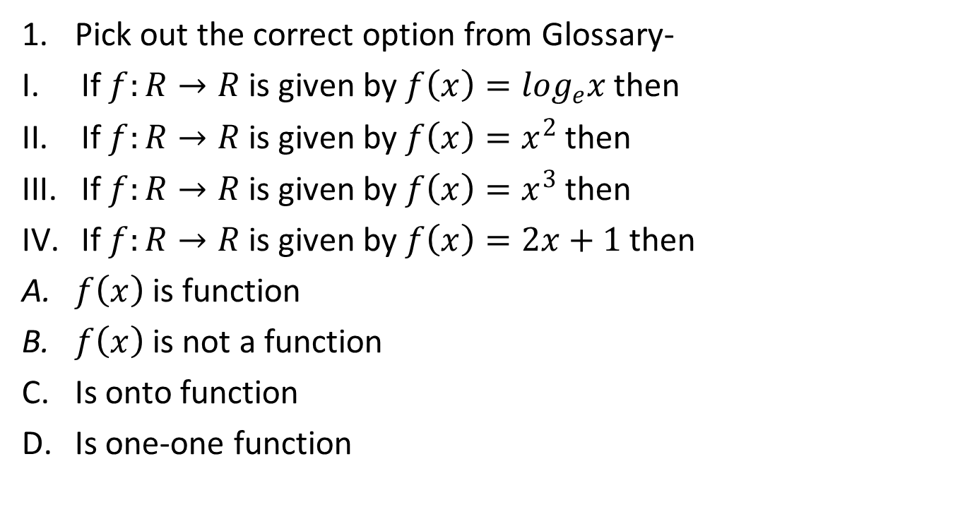
Glossary Questions(CO5)
Pick out the correct option from Glossary-
If $f:R→R$ is given by $f\left(x\right)=\log_{e}x$ then
If $f:R→R$ is given by $f\left(x\right)=x^{2}$ then
If $f:R→R$ is given by $f\left(x\right)=x^{3}$ then
If $f:R→R$ is given by $f\left(x\right)=2x+1$ then
$f\left(x\right)$ is function
$f\left(x\right)$ is not a function
Is onto function
Is one-one function

Slide 115
Glossary Questions (CO5)
2. Pick out the correct option from Glossary-
50
415624
294678
149264
Has 6 divisor
Is divisible by 11
Is divisible by 19
Is divisible by 17

Slide 116
Old Question Papers

Slide 117
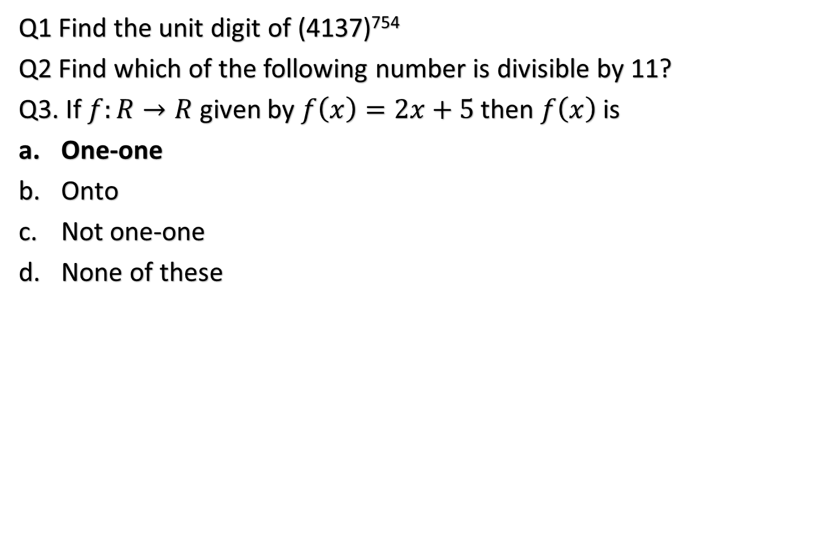
Expected Questions for University Exam (CO5)
Q1 Find the unit digit of (4137)⁷⁵⁴
Q2 Find which of the following number is divisible by 11?
Q3. If $f:R→R$ given by $f\left(x\right)=2x+5$ then $f\left(x\right)$ is
One-one
Onto
Not one-one
None of these

Slide 118
Expected Questions for University Exam (CO5)
Q4. The following pie-chart represents the result of 600 successful students in various subject of an examination. Study the Pie-chart and answer question.

Slide 119
Expected Questions for University Exam (CO5)
(i) The ratio of students who passed in Bengali, to the students who passed in History is
A. 1 : 2
B. 2 : 1
C. 3 : 4
D. 3 : 5
(ii) The number of students passed in Bengali is greater than the number of students passed in History by
A. 150
B. 60
C. 120
D. 100

Slide 120
Expected Questions for University Exam (CO5)
(iii) The percentage of students who passed in English is
A. 15%
B. 20%
C. 5%
D. 12%
(iv) The number of students passed in English is less than the number of students passed in
Mathematics by
A. 50
B. 60
C. 90
D. 75

Slide 121
Expected Questions for University Exam (CO5)
(v) The number of students who passed in Bengali is –
A. 240
B. 320
C. 180
D. 140

Slide 122
Expected Questions for University Exam (CO5)
Q5. Statements: All green are blue. All blue are white.
Conclusions:
Some blue are green.
Some white are green.
Some green are not white.
All white are blue.
Then
Only (1) and (2)
Only (1) and (3)
Only (1) and (4)
Only (2) and (4)

Slide 123
References
Reference Books
1. Operation Research : Theory and Application by J.K Sharma.
2. Operation Research by Kanti Swarup,Man Mohan and P.K Gupta.
3. Operations Research: An Introduction, Global Edition by Hamdy A. Taha Hamdy
4. Introduction to Operations Research by Hillier Lieberman
5. R.K. Jain and S.R.K. Iyenger: Advance Engineering Mathematics; Narosa Publishing House, New Delhi.

Slide 124
Thank You

